Slide 1


Deep Neural Network
Sung Kim

Slide 2
Deep Neural Network
Sung Kim

Slide 3
Recap: Machine Learning Basics
Linear Regression
Logistic Regression (Binary classification)
Softmax Classification

Slide 4
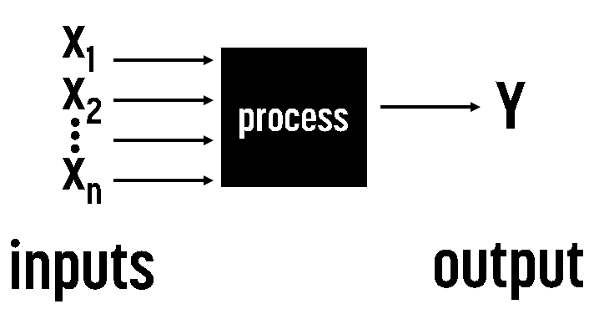

Regression

Slide 5
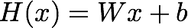
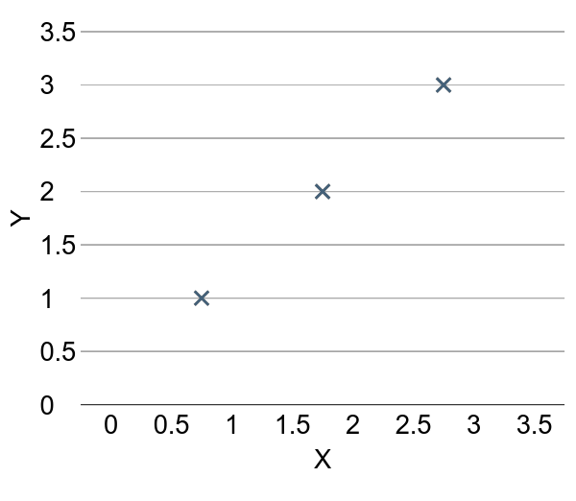
(Linear) Hypothesis

Slide 6
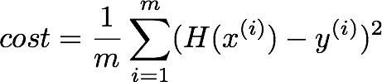
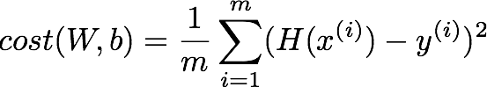
Cost function

Slide 7
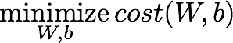
Goal: Minimize cost

Slide 8
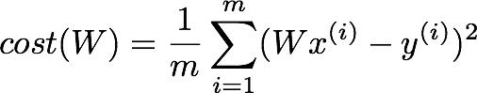
What cost(W) looks like?
x | Y
1 | 1
2 | 2
3 | 3
W=1, cost(W)=?

Slide 9
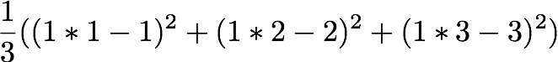
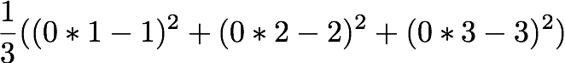
What cost(W) looks like?
x | Y
1 | 1
2 | 2
3 | 3
W=1, cost(W)=0
W=0, cost(W)=4.67
W=2, cost(W)=?

Slide 10
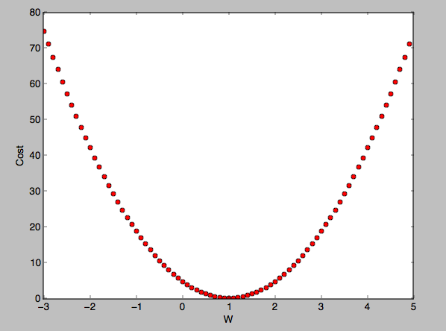
What cost(W) looks like?
W=1, cost(W)=0
W=0, cost(W)=4.67
W=2, cost(W)=4.67

Slide 11
How to minimize cost?

Slide 12
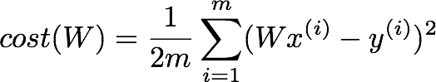
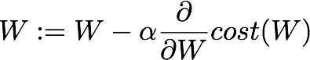
Formal definition

Slide 13

Classification

Slide 14
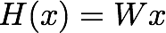
Linear Regression Hypothesis

Slide 15
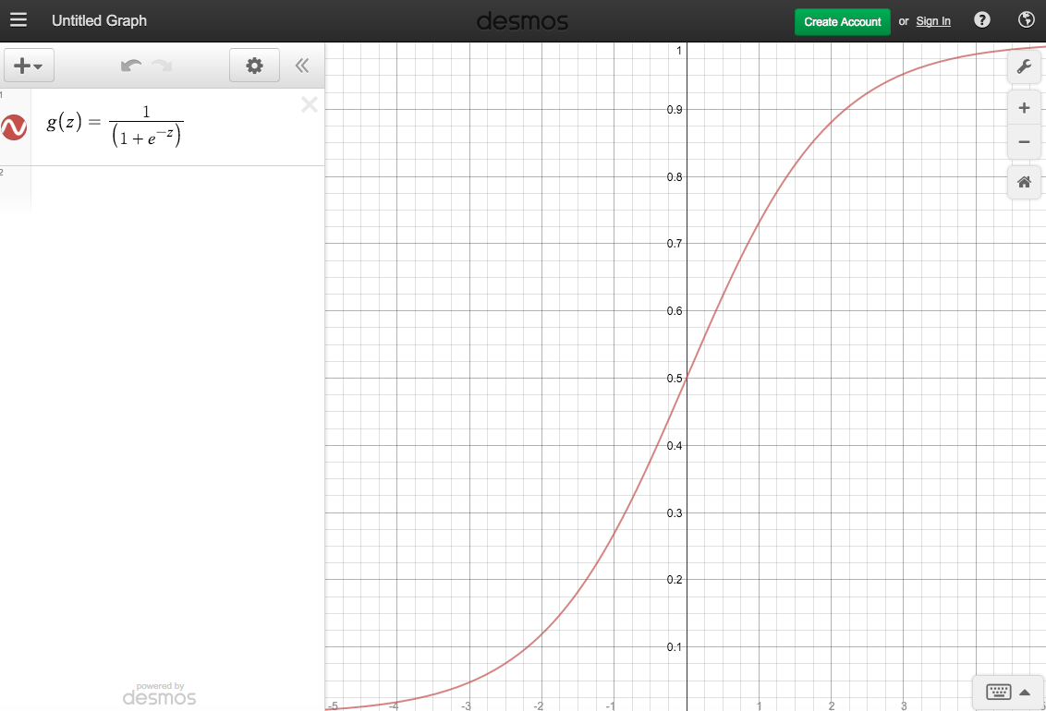
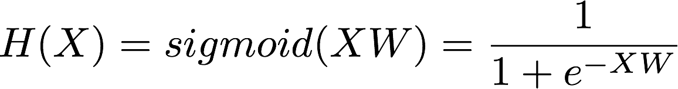
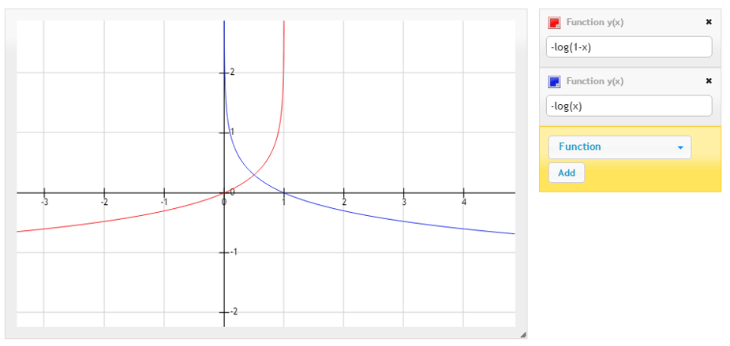
Logistic Regression
Case for y=1
Case for y=0
Notes:
H(X) = \frac{1}{1 + e^{-W^{T}X}} \\
H(X) = sigmoid(XW) = \frac{1}{1 + e^{-XW}} \\
cost(W)=-\frac{1}{m}\sum {\color{blue}y} log(H(x)) + {\color{blue}(1-y)}(log(1-H(x)) \\
W = W - \alpha\frac{\partial}{\partial W}cost(W)

Slide 16
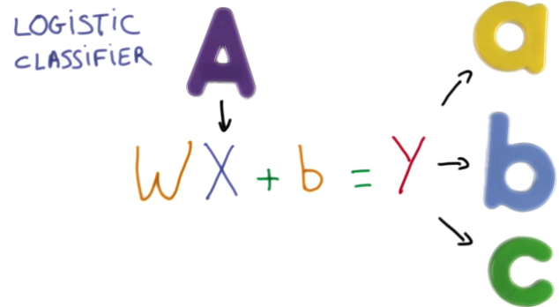
Multiple labels (a, b, c)

Slide 17
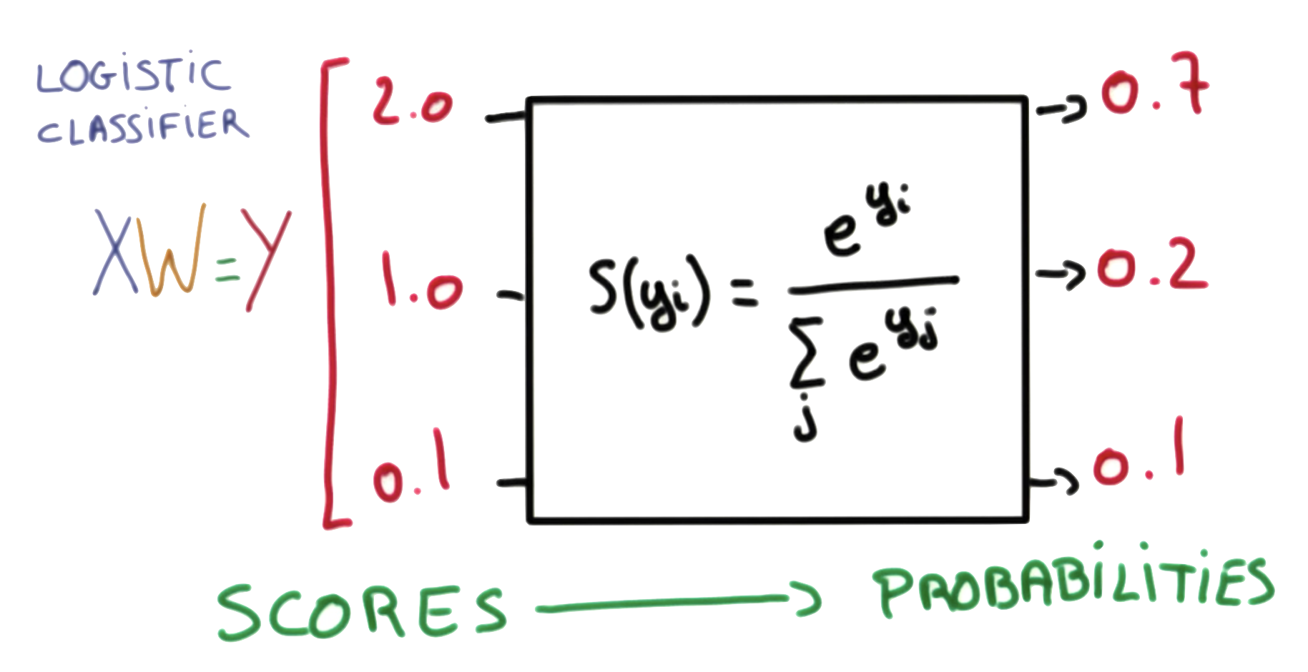
Softmax function
https://www.udacity.com/course/viewer#!/c-ud730/l-6370362152/m-6379811817
Notes:
P(y=i|x) = S(y_{i}) = \frac{e^{y_{i}}}{\sum_{j}e^{y_{j}}} \in (0,1)

Slide 18
hypothesis = tf.nn.softmax(tf.matmul(X,W)+b)
tf.matmul(X,W)+b
https://www.udacity.com/course/viewer#!/c-ud730/l-6370362152/m-6379811817

Slide 19
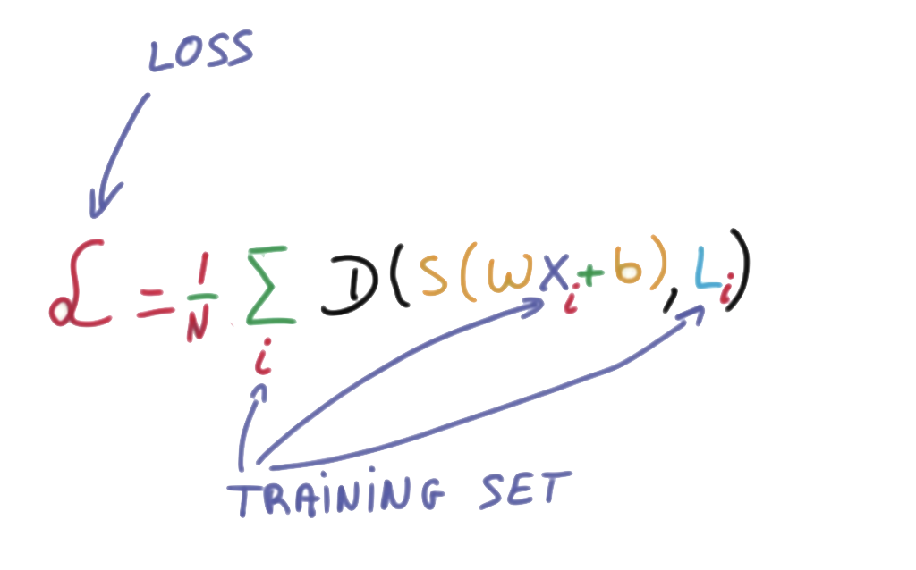
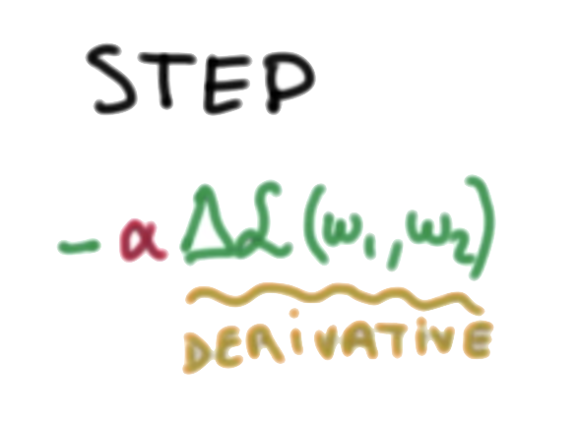
Cost function: cross entropy
# Cross entropy cost/loss
cost = tf.reduce_mean(-tf.reduce_sum(Y * tf.log(hypothesis), axis=1))
https://www.udacity.com/course/viewer#!/c-ud730/l-6370362152/m-6379811817

Slide 20
Cost function: cross entropy
hypothesis = tf.nn.softmax(tf.matmul(X,W)+b)
# Cross entropy cost/loss
cost = tf.reduce_mean
(-tf.reduce_sum(Y * tf.log(hypothesis), axis=1))
optimizer = tf.train.GradientDescentOptimizer(learning_rate=0.1).
minimize(cost)
https://www.udacity.com/course/viewer#!/c-ud730/l-6370362152/m-6379811817

Slide 21
Recap: Machine Learning Basics
Linear Regression
Logistic Regression (Binary classification)
Softmax Classification

Slide 22
Today
XOR with Logistic Regression (Binary classification)
Solution: Deep Neural Network
Challenges of DNN
Computing gradients: chain rules and back propagation
Vanishing Gradients: Relu
Overfitting: regularization, dropouts

Slide 23
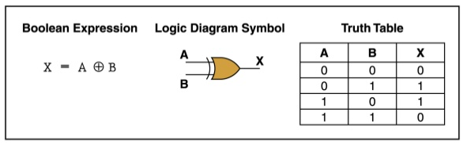
XOR data set
x_data = np.array([[0, 0], [0, 1], [1, 0], [1, 1]], dtype=np.float32)
y_data = np.array([[0], [1], [1], [0]], dtype=np.float32)
http://templ25.mandaringardencity.com/xor-gate-truth-table-2/

Slide 24
Logistic regression
x_data = np.array([[0, 0], [0, 1], [1, 0], [1, 1]], dtype=np.float32)
y_data = np.array([[0], [1], [1], [0]], dtype=np.float32)
W = tf.Variable(tf.random_normal([2, 1]), name='weight')
b = tf.Variable(tf.random_normal([1]), name='bias')
# Hypothesis using sigmoid: tf.div(1., 1. + tf.exp(tf.matmul(X, W)))
hypothesis = tf.sigmoid(tf.matmul(X, W) + b)
https://github.com/hunkim/DeepLearningZeroToAll/blob/master/lab-09-1-xor.py

Slide 25
XOR with
logistic regression?
But
it doesn’t work
x_data = np.array([[0, 0], [0, 1], [1, 0], [1, 1]], dtype=np.float32)
y_data = np.array([[0], [1], [1], [0]], dtype=np.float32)
X = tf.placeholder(tf.float32)
Y = tf.placeholder(tf.float32)
W = tf.Variable(tf.random_normal([2, 1]), name='weight')
b = tf.Variable(tf.random_normal([1]), name='bias')
# Hypothesis using sigmoid: tf.div(1., 1. + tf.exp(tf.matmul(X, W)))
hypothesis = tf.sigmoid(tf.matmul(X, W) + b)
# cost/loss function
cost = -tf.reduce_mean(Y * tf.log(hypothesis) + (1 - Y) * tf.log(1 - hypothesis))
train = tf.train.GradientDescentOptimizer(learning_rate=0.1).minimize(cost)
# Accuracy computation
# True if hypothesis>0.5 else False
predicted = tf.cast(hypothesis > 0.5, dtype=tf.float32)
accuracy = tf.reduce_mean(tf.cast(tf.equal(predicted, Y), dtype=tf.float32))
# Launch graph
with tf.Session() as sess:
# Initialize TensorFlow variables
sess.run(tf.global_variables_initializer())
for step in range(10001):
sess.run(train, feed_dict={X: x_data, Y: y_data})
if step % 100 == 0:
print(step, sess.run(cost, feed_dict={X: x_data, Y: y_data}), sess.run(W))
# Accuracy report
h, c, a = sess.run([hypothesis, predicted, accuracy], feed_dict={X: x_data, Y: y_data})
print("\nHypothesis: ", h, "\nCorrect: ", c, "\nAccuracy: ", a)
https://github.com/hunkim/DeepLearningZeroToAll/blob/master/lab-09-1-xor.py

Slide 26
XOR with
logistic regression?
But
it doesn’t work!
x_data = np.array([[0, 0], [0, 1], [1, 0], [1, 1]], dtype=np.float32)
y_data = np.array([[0], [1], [1], [0]], dtype=np.float32)
X = tf.placeholder(tf.float32)
Y = tf.placeholder(tf.float32)
W = tf.Variable(tf.random_normal([2, 1]), name='weight')
b = tf.Variable(tf.random_normal([1]), name='bias')
# Hypothesis using sigmoid: tf.div(1., 1. + tf.exp(tf.matmul(X, W)))
hypothesis = tf.sigmoid(tf.matmul(X, W) + b)
# cost/loss function
cost = -tf.reduce_mean(Y * tf.log(hypothesis) + (1 - Y) * tf.log(1 - hypothesis))
train = tf.train.GradientDescentOptimizer(learning_rate=0.1).minimize(cost)
# Accuracy computation
# True if hypothesis>0.5 else False
predicted = tf.cast(hypothesis > 0.5, dtype=tf.float32)
accuracy = tf.reduce_mean(tf.cast(tf.equal(predicted, Y), dtype=tf.float32))
# Launch graph
with tf.Session() as sess:
# Initialize TensorFlow variables
sess.run(tf.global_variables_initializer())
for step in range(10001):
sess.run(train, feed_dict={X: x_data, Y: y_data})
if step % 100 == 0:
print(step, sess.run(cost, feed_dict={X: x_data, Y: y_data}), sess.run(W))
# Accuracy report
h, c, a = sess.run([hypothesis, predicted, accuracy], feed_dict={X: x_data, Y: y_data})
print("\nHypothesis: ", h, "\nCorrect: ", c, "\nAccuracy: ", a)
Hypothesis:
[[ 0.5]
[ 0.5]
[ 0.5]
[ 0.5]]
Correct:
[[ 0.]
[ 0.]
[ 0.]
[ 0.]]
Accuracy: 0.5
https://github.com/hunkim/DeepLearningZeroToAll/blob/master/lab-09-1-xor.py

Slide 27
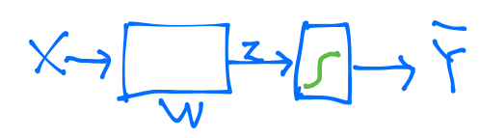
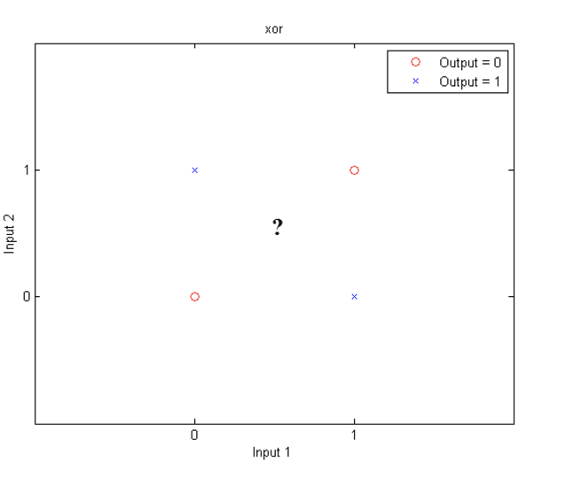
One logistic regression unit cannot separate XOR
http://matlabgeeks.com/tips-tutorials/neural-networks-a-multilayer-perceptron-in-matlab/
Notes:
어디서 많이 본것? 이걸 붙여서 여러개의 출력이 되는 구조.

Slide 28
How about multiple logistic regression units
Notes:
어디서 많이 본것? 이걸 붙여서 여러개의 출력이 되는 구조.

Slide 29
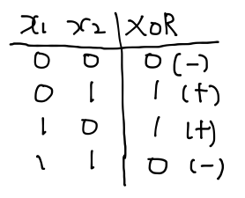
XOR using NN

Slide 30
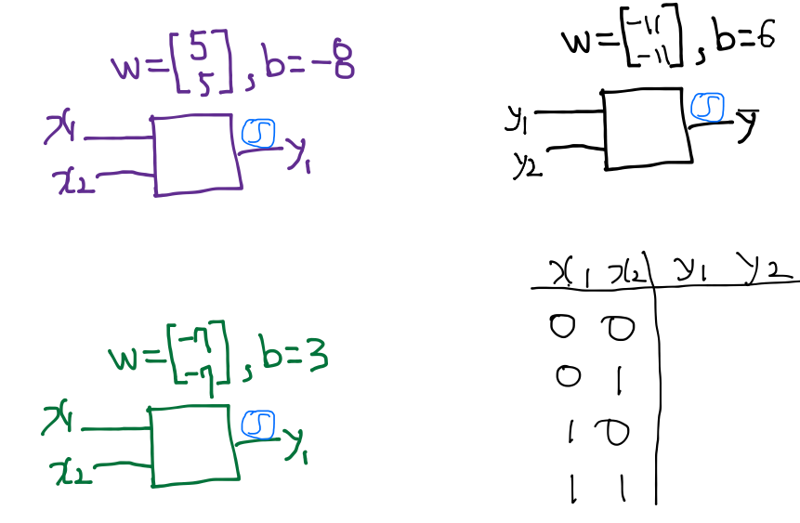
Neural Net

Slide 31
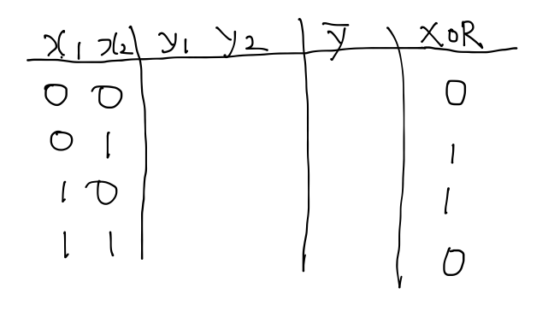
Neural Net

Slide 32
Neural Net

Slide 33
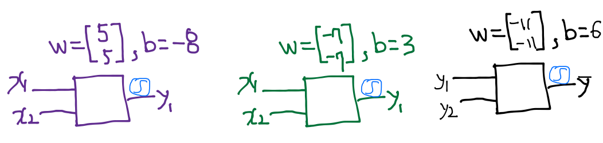
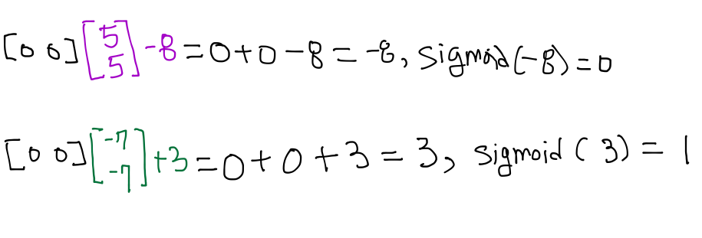
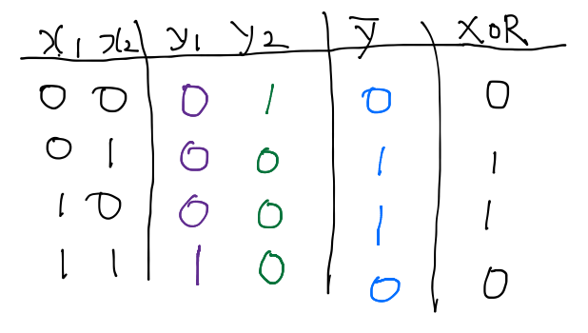
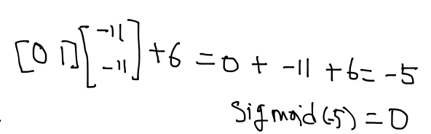

Slide 35
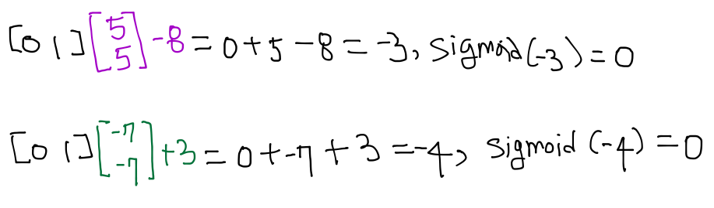
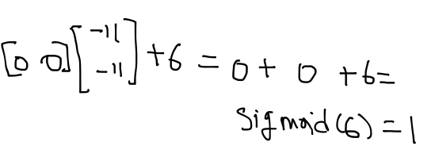

Slide 36
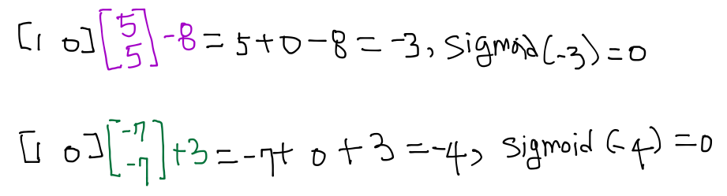
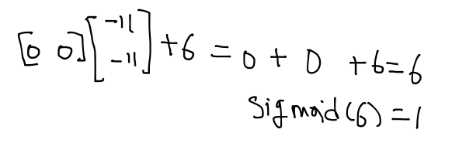

Slide 37
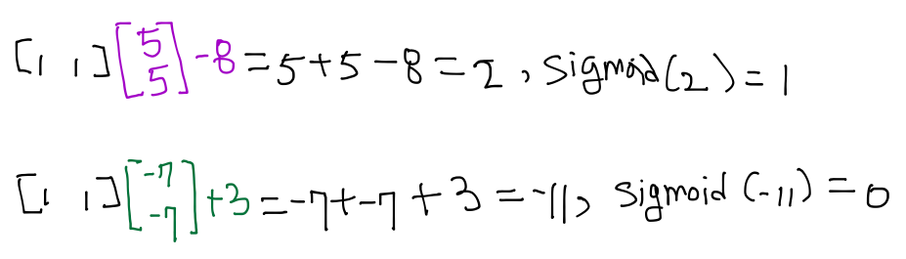
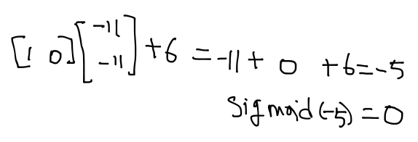

Slide 38
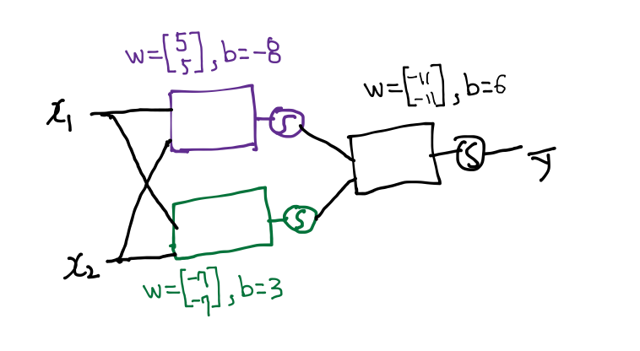
Forward propagation

Slide 39
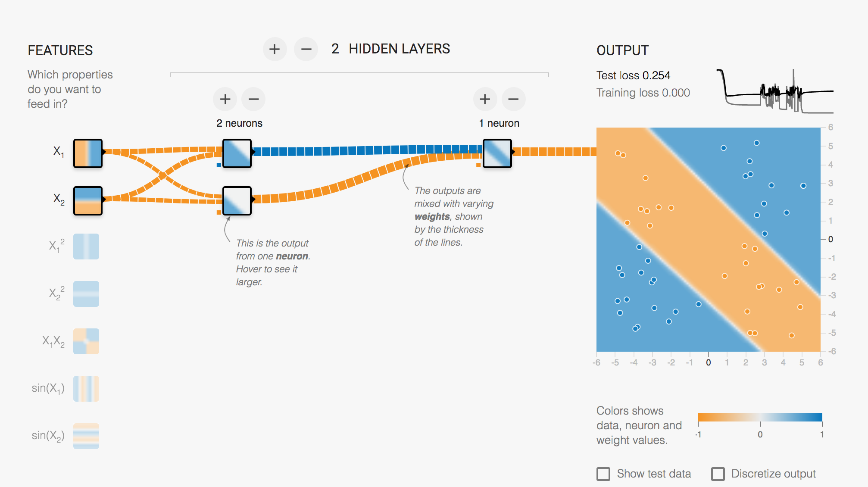
http://playground.tensorflow.org/

Slide 40
Forward propagation
Can you find another W and b for the XOR?

Slide 41
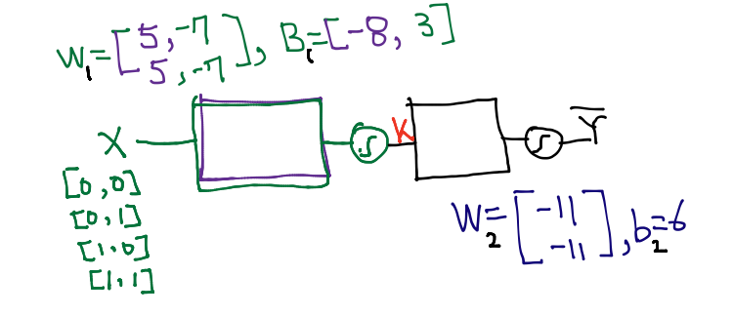

NN

Slide 42
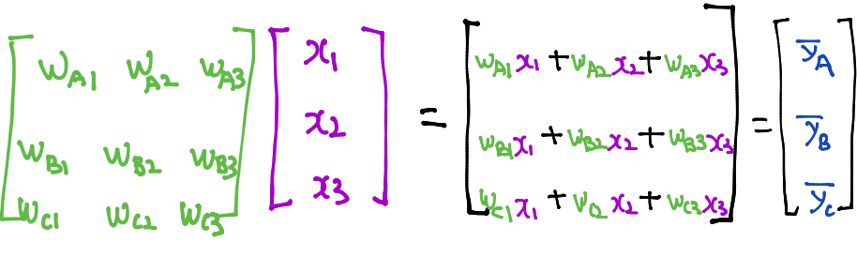
Recap: Multinomial classification

Slide 43
NN
How can we learn W, and b from traning data?

Slide 44
Neural Net
W = tf.Variable(tf.random_normal([2, 1]), name='weight')
b = tf.Variable(tf.random_normal([1]), name='bias')
# Hypothesis using sigmoid: tf.div(1., 1. + tf.exp(tf.matmul(X, W)))
hypothesis = tf.sigmoid(tf.matmul(X, W) + b)
https://github.com/hunkim/DeepLearningZeroToAll/blob/master/lab-09-1-xor.py

Slide 45
Neural Net
W = tf.Variable(tf.random_normal([2, 1]), name='weight')
b = tf.Variable(tf.random_normal([1]), name='bias')
# Hypothesis using sigmoid: tf.div(1., 1. + tf.exp(tf.matmul(X, W)))
hypothesis = tf.sigmoid(tf.matmul(X, W) + b)
W1 = tf.Variable(tf.random_normal([2, 2]), name='weight1')
b1 = tf.Variable(tf.random_normal([2]), name='bias1')
layer1 = tf.sigmoid(tf.matmul(X, W1) + b1)
W2 = tf.Variable(tf.random_normal([2, 1]), name='weight2')
b2 = tf.Variable(tf.random_normal([1]), name='bias2')
hypothesis = tf.sigmoid(tf.matmul(layer1, W2) + b2)
https://github.com/hunkim/DeepLearningZeroToAll/blob/master/lab-09-2-xor-nn.py

Slide 46
NN for XOR
x_data = np.array([[0, 0], [0, 1], [1, 0], [1, 1]], dtype=np.float32)
y_data = np.array([[0], [1], [1], [0]], dtype=np.float32)
X = tf.placeholder(tf.float32)
Y = tf.placeholder(tf.float32)
W1 = tf.Variable(tf.random_normal([2, 2]), name='weight1')
b1 = tf.Variable(tf.random_normal([2]), name='bias1')
layer1 = tf.sigmoid(tf.matmul(X, W1) + b1)
W2 = tf.Variable(tf.random_normal([2, 1]), name='weight2')
b2 = tf.Variable(tf.random_normal([1]), name='bias2')
hypothesis = tf.sigmoid(tf.matmul(layer1, W2) + b2)
# cost/loss function
cost = -tf.reduce_mean(Y * tf.log(hypothesis) + (1 - Y) * tf.log(1 - hypothesis))
train = tf.train.GradientDescentOptimizer(learning_rate=0.1).minimize(cost)
# Accuracy computation
# True if hypothesis>0.5 else False
predicted = tf.cast(hypothesis > 0.5, dtype=tf.float32)
accuracy = tf.reduce_mean(tf.cast(tf.equal(predicted, Y), dtype=tf.float32))
# Launch graph
with tf.Session() as sess:
# Initialize TensorFlow variables
sess.run(tf.global_variables_initializer())
for step in range(10001):
sess.run(train, feed_dict={X: x_data, Y: y_data})
if step % 100 == 0:
print(step, sess.run(cost, feed_dict={X: x_data, Y: y_data}), sess.run([W1, W2]))
# Accuracy report
h, c, a = sess.run([hypothesis, predicted, accuracy],
feed_dict={X: x_data, Y: y_data})
print("\nHypothesis: ", h, "\nCorrect: ", c, "\nAccuracy: ", a)
Hypothesis:
[[ 0.01338218]
[ 0.98166394]
[ 0.98809403]
[ 0.01135799]]
Correct:
[[ 0.]
[ 1.]
[ 1.]
[ 0.]]
Accuracy: 1.0
https://github.com/hunkim/DeepLearningZeroToAll/blob/master/lab-09-2-xor-nn.py

Slide 47
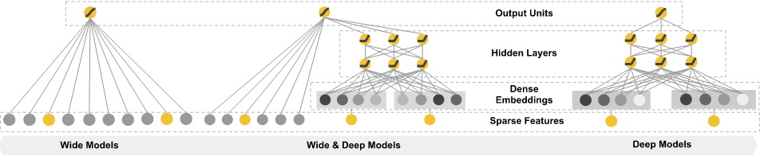
Wide NN for XOR
W1 = tf.Variable(tf.random_normal([2, 10]), name='weight1')
b1 = tf.Variable(tf.random_normal([10]), name='bias1')
layer1 = tf.sigmoid(tf.matmul(X, W1) + b1)
W2 = tf.Variable(tf.random_normal([10, 1]), name='weight2')
b2 = tf.Variable(tf.random_normal([1]), name='bias2')
hypothesis = tf.sigmoid(tf.matmul(layer1, W2) + b2)
[2,10], [10,1]
Hypothesis:
[[ 0.00358802]
[ 0.99366933]
[ 0.99204296]
[ 0.0095663 ]]
Correct:
[[ 0.]
[ 1.]
[ 1.]
[ 0.]]
Accuracy: 1.0
[2,2], [2,1]
Hypothesis:
[[ 0.01338218]
[ 0.98166394]
[ 0.98809403]
[ 0.01135799]]
Correct:
[[ 0.]
[ 1.]
[ 1.]
[ 0.]]
Accuracy: 1.0
https://github.com/hunkim/DeepLearningZeroToAll/blob/master/lab-09-3-xor-nn-wide-deep.py

Slide 48
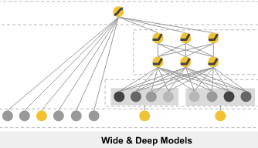
Deep NN for XOR
W1 = tf.Variable(tf.random_normal([2, 10]), name='weight1')
b1 = tf.Variable(tf.random_normal([10]), name='bias1')
layer1 = tf.sigmoid(tf.matmul(X, W1) + b1)
W2 = tf.Variable(tf.random_normal([10, 10]), name='weight2')
b2 = tf.Variable(tf.random_normal([10]), name='bias2')
layer2 = tf.sigmoid(tf.matmul(layer1, W2) + b2)
W3 = tf.Variable(tf.random_normal([10, 10]), name='weight3')
b3 = tf.Variable(tf.random_normal([10]), name='bias3')
layer3 = tf.sigmoid(tf.matmul(layer2, W3) + b3)
W4 = tf.Variable(tf.random_normal([10, 1]), name='weight4')
b4 = tf.Variable(tf.random_normal([1]), name='bias4')
hypothesis = tf.sigmoid(tf.matmul(layer3, W4) + b4)
4 layers
Hypothesis:
[[ 7.80e-04]
[ 9.99e-01]
[ 9.98e-01]
[ 1.55e-03]]
Correct:
[[ 0.]
[ 1.]
[ 1.]
[ 0.]]
Accuracy: 1.0
2 layers
Hypothesis:
[[ 0.01338218]
[ 0.98166394]
[ 0.98809403]
[ 0.01135799]]
Correct:
[[ 0.]
[ 1.]
[ 1.]
[ 0.]]
Accuracy: 1.0
https://github.com/hunkim/DeepLearningZeroToAll/blob/master/lab-09-3-xor-nn-wide-deep.py

Slide 49
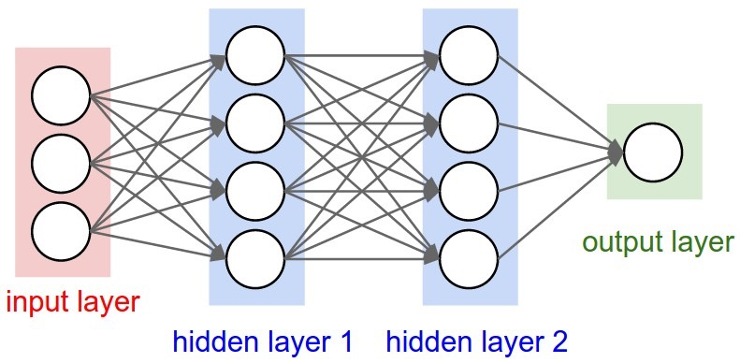
Minimizing cost: Derivation

Slide 50
Recap: How to minimize cost?
Cost (W) = ...

Slide 51
Minimizing cost: Derivation

Slide 52

Formal definition

Slide 53
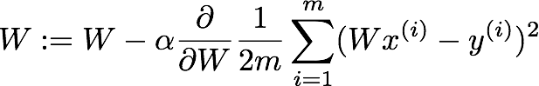
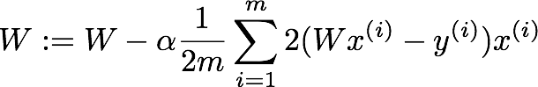
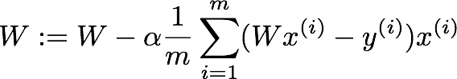
Formal definition

Slide 54
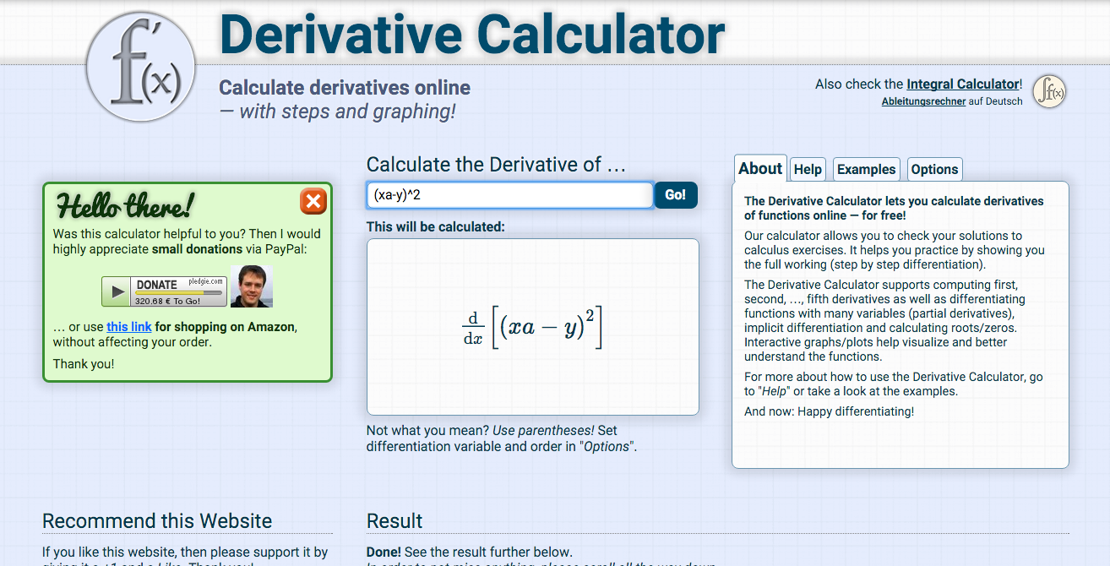

Slide 55
Gradient descent algorithm

Slide 56
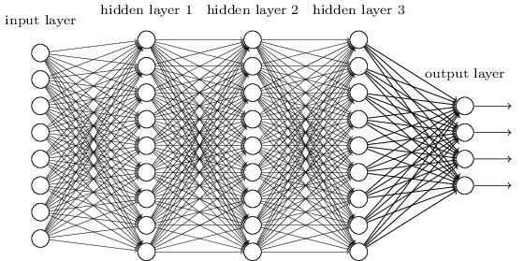
How about this case?

Slide 57
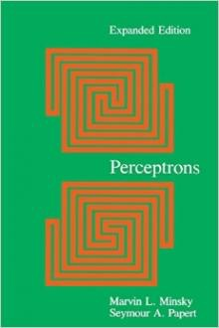
Perceptrons (1969)
by Marvin Minsky, founder of the MIT AI Lab
We need to use MLP, multilayer perceptrons (multilayer neural nets)
No one on earth had found a viable way to train MLPs good enough to learn such simple functions.
Notes:
Minsky’s book convinced most of the world that neural networks were a discredited dead-end – the worst kind of heresy.
SKynet == DeepNet, 반란군이 보낸 분일지도: Neural Network 20년 정도 발전을 늦게 함.

Slide 58
Neural Network (NN)
“No one on earth had found a viable way to train*”
*Marvin Minsky
http://cs231n.github.io/convolutional-networks/
Notes:
이런이야기: 몇개 더 넣어야 하는데, 나도 그 학습 방법을 모르는데, 너희도 안된다. 글을 잘 쓰신듯. 매우 설득력있었고 모두에게 받아 들여짐. AI 의 암흑기. 69-86

Slide 59
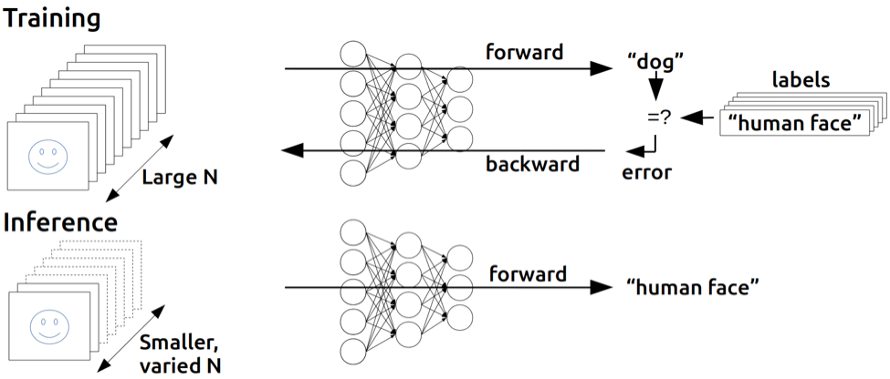
Backpropagation
(1974, 1982 by Paul Werbos, 1986 by Hinton)
https://devblogs.nvidia.com/parallelforall/inference-next-step-gpu-accelerated-deep-learning/
Notes:
민스키의 말을 듣지 않음 사람. 귓등으로 흘린분. Hinton.

Slide 60


Back propagation (chain rule)

Slide 61
Back propagation (chain rule)

Slide 62
Back propagation (chain rule)

Slide 63




Basic derivative
https://ko.wikipedia.org/wiki/%EB%AF%B8%EB%B6%84
Notes:
순간변화율!

Slide 64


Partial derivative:
consider other variables as constants
https://ko.wikipedia.org/wiki/%EB%AF%B8%EB%B6%84
Notes:
The symbol ∂ looks sort of like a backwards lower-case delta, δ. It is usually read simply as “partial”, and ∂f/∂x is read as “partial f partial x”. Occasionally, the symbol ∂ is referred to as a “round d”. derivative: ∂h ∂t = dh dt = 5+ 1 t .

Slide 65




Partial derivative:
consider other variables as constants
https://ko.wikipedia.org/wiki/%EB%AF%B8%EB%B6%84
Notes:
The symbol ∂ looks sort of like a backwards lower-case delta, δ. It is usually read simply as “partial”, and ∂f/∂x is read as “partial f partial x”. Occasionally, the symbol ∂ is referred to as a “round d”. derivative: ∂h ∂t = dh dt = 5+ 1 t .

Slide 66

Chain Rule
http://www.mathcentre.ac.uk/resources/uploaded/mc-ty-chain-2009-1.pdf

Slide 67
Chain Rule
x
g()
f()
y
http://www.mathcentre.ac.uk/resources/uploaded/mc-ty-chain-2009-1.pdf

Slide 68
Back propagation (chain rule)
http://cs231n.stanford.edu/

Slide 69
Back propagation (chain rule)
http://cs231n.stanford.edu/

Slide 70
Back propagation (chain rule)
http://cs231n.stanford.edu/

Slide 71
Back propagation (chain rule)
http://cs231n.stanford.edu/

Slide 72
Back propagation (chain rule)
http://cs231n.stanford.edu/

Slide 73
Back propagation (chain rule)
w
http://cs231n.stanford.edu/

Slide 74

Back propagation (chain rule)
http://cs231n.stanford.edu/

Slide 75
Back propagation (chain rule)
http://cs231n.stanford.edu/

Slide 76

Sigmoid

Slide 77
Sigmoid

Slide 78

Back propagation in
TensorFlow

Slide 79

Back propagation in
TensorFlow

Slide 80
Back propagation

Slide 81
Now we know how to get derivative: backpropagation

Slide 82

Gradient descent algorithm

Slide 83

Tensorflow
train = tf.train.GradientDescentOptimizer(learning_rate=0.1).minimize(cost)

Slide 84
“Yes you should understand backprop”
“If you try to ignore how it works under the hood because TensorFlow automagically makes my networks learn”
“You will not be ready to wrestle with the dangers it presents”
“You will be much less effective at building and debugging neural networks.”
“The good news is that backpropagation is not that difficult to understand”
“if presented properly.”
https://medium.com/@karpathy/yes-you-should-understand-backprop-e2f06eab496b

Slide 85

https://www.quora.com/What-did-Richard-Feynman-mean-when-he-said-What-I-cannot-create-I-do-not-understand

Slide 86

Logistic Regression Network
a₀
*
+
Sigmoid
loss
w
b
Notes:
E=loss(a_1, t) = -\sum{t*log(a_1) + (1-t)*log(1-a_1)}
(1)\frac{\partial{E}}{\partial{a_1}}
(2)\frac{\partial{E}}{\partial{l}}={\color{blue}\frac{\partial{E}}{\partial{a_1}}}\frac{\partial{a_1}}{\partial{l}}
(3)\frac{\partial{E}}{\partial{b}}={\color{blue}\frac{\partial{E}}{\partial{l}}}\frac{\partial{l}}{\partial{b}}
(4)\frac{\partial{E}}{\partial{o}}={\color{blue}\frac{\partial{E}}{\partial{l}}}\frac{\partial{l}}{\partial{o}}
(5)\frac{\partial{E}}{\partial{w_2}}=\frac{\partial{E}}{\partial{o_2}}\frac{\partial{o_2}}{\partial{w_2}}
=== pre-computed- derivative
l=o+b,~\frac{\partial{l}}{\partial{o}}=1,~\frac{\partial{l}}{\partial{b}}=1
o=aw,~\frac{\partial{o}}{\partial{w}}=a,~\frac{\partial{o}}{\partial{a}}=w
o=sigmoid(l)=\frac{1}{1+e^{-l}},~\frac{\partial{a}}{\partial{l}}=a(1-a)
E=\frac{1}{2}(a-t)^2,~ \frac{\partial{E}}{\partial{a}}=a-t
E=-\sum{t*log(a)+(1-t)*log(1-a)}, ~ \frac{\partial{E}}{\partial{a}}=\frac{a-t}{a(1-a)}
=== Solutions
(1)\frac{\partial{E}}{\partial{a_1}}=\frac{a_1-t}{a_1(1-a_1)}
(2)\frac{\partial{E}}{\partial{l}}=\frac{\partial{E}}{\partial{a_1}}{\color{cyan}\frac{\partial{a_1}}{\partial{l}}}=\frac{a_1-t}{a_1(1-a_1)}*{\color{cyan} a_1(1-a_1)=a_1-t}
(3)\frac{\partial{E}}{\partial{b}}=\frac{\partial{E}}{\partial{l}}{\color{cyan}\frac{\partial{l}}{\partial{b}}}
=\frac{\partial{E}}{\partial{l}}*{\color{cyan}1}
(4)\frac{\partial{E}}{\partial{o}}=\frac{\partial{E}}{\partial{l}}{\color{cyan}\frac{\partial{l}}{\partial{o}}}
=\frac{\partial{E}}{\partial{l}}*{\color{cyan}1}
(5)\frac{\partial{E}}{\partial{w}}=\frac{\partial{E}}{\partial{o}}{\color{cyan}\frac{\partial{o}}{\partial{w}}}=\frac{\partial{E}}{\partial{o}}{\color{cyan}a_0}
=== Network update
w = w - \alpha \frac{\partial{E}}{\partial{w}}
b = b - \alpha \frac{\partial{E}}{\partial{b}}

Slide 87
Network
forward
*
(1) o=a₀*w
+
(2) l=o+b
Sigmoid
(3) a₁=sigmoid(l)
loss
(4) E=loss(a₁,t)
a₀
w
b
Forward pass, OK? Just follow (1), (2), (3) and (4)
Notes:
E=loss(a_1, t) = -\sum{t*log(a_1) + (1-t)*log(1-a_1)}
(1)\frac{\partial{E}}{\partial{a_1}}
(2)\frac{\partial{E}}{\partial{l}}={\color{blue}\frac{\partial{E}}{\partial{a_1}}}\frac{\partial{a_1}}{\partial{l}}
(3)\frac{\partial{E}}{\partial{b}}={\color{blue}\frac{\partial{E}}{\partial{l}}}\frac{\partial{l}}{\partial{b}}
(4)\frac{\partial{E}}{\partial{o}}={\color{blue}\frac{\partial{E}}{\partial{l}}}\frac{\partial{l}}{\partial{o}}
(5)\frac{\partial{E}}{\partial{w_2}}=\frac{\partial{E}}{\partial{o_2}}\frac{\partial{o_2}}{\partial{w_2}}
=== pre-computed- derivative
l=o+b,~\frac{\partial{l}}{\partial{o}}=1,~\frac{\partial{l}}{\partial{b}}=1
o=aw,~\frac{\partial{o}}{\partial{w}}=a,~\frac{\partial{o}}{\partial{a}}=w
o=sigmoid(l)=\frac{1}{1+e^{-l}},~\frac{\partial{a}}{\partial{l}}=a(1-a)
E=\frac{1}{2}(a-t)^2,~ \frac{\partial{E}}{\partial{a}}=a-t
E=-\sum{t*log(a)+(1-t)*log(1-a)}, ~ \frac{\partial{E}}{\partial{a}}=\frac{a-t}{a(1-a)}
=== Solutions
(1)\frac{\partial{E}}{\partial{a_1}}=\frac{a_1-t}{a_1(1-a_1)}
(2)\frac{\partial{E}}{\partial{l}}=\frac{\partial{E}}{\partial{a_1}}{\color{cyan}\frac{\partial{a_1}}{\partial{l}}}=\frac{a_1-t}{a_1(1-a_1)}*{\color{cyan} a_1(1-a_1)=a_1-t}
(3)\frac{\partial{E}}{\partial{b}}=\frac{\partial{E}}{\partial{l}}{\color{cyan}\frac{\partial{l}}{\partial{b}}}
=\frac{\partial{E}}{\partial{l}}*{\color{cyan}1}
(4)\frac{\partial{E}}{\partial{o}}=\frac{\partial{E}}{\partial{l}}{\color{cyan}\frac{\partial{l}}{\partial{o}}}
=\frac{\partial{E}}{\partial{l}}*{\color{cyan}1}
(5)\frac{\partial{E}}{\partial{w}}=\frac{\partial{E}}{\partial{o}}{\color{cyan}\frac{\partial{o}}{\partial{w}}}=\frac{\partial{E}}{\partial{o}}{\color{cyan}a_0}
=== Network update
w = w - \alpha \frac{\partial{E}}{\partial{w}}
b = b - \alpha \frac{\partial{E}}{\partial{b}}

Slide 88
Network
forward
*
(1) o=a₀*w
+
(2) l=o+b
Sigmoid
(3) a₁=sigmoid(l)
loss
(4) E=loss(a₁,t)
a₀
w
b
Notes:
E=loss(a_1, t) = -\sum{t*log(a_1) + (1-t)*log(1-a_1)}
(1)\frac{\partial{E}}{\partial{a_1}}
(2)\frac{\partial{E}}{\partial{l}}={\color{blue}\frac{\partial{E}}{\partial{a_1}}}\frac{\partial{a_1}}{\partial{l}}
(3)\frac{\partial{E}}{\partial{b}}={\color{blue}\frac{\partial{E}}{\partial{l}}}\frac{\partial{l}}{\partial{b}}
(4)\frac{\partial{E}}{\partial{o}}={\color{blue}\frac{\partial{E}}{\partial{l}}}\frac{\partial{l}}{\partial{o}}
(5)\frac{\partial{E}}{\partial{w_2}}=\frac{\partial{E}}{\partial{o_2}}\frac{\partial{o_2}}{\partial{w_2}}
=== pre-computed- derivative
l=o+b,~\frac{\partial{l}}{\partial{o}}=1,~\frac{\partial{l}}{\partial{b}}=1
o=aw,~\frac{\partial{o}}{\partial{w}}=a,~\frac{\partial{o}}{\partial{a}}=w
o=sigmoid(l)=\frac{1}{1+e^{-l}},~\frac{\partial{a}}{\partial{l}}=a(1-a)
E=\frac{1}{2}(a-t)^2,~ \frac{\partial{E}}{\partial{a}}=a-t
E=-\sum{t*log(a)+(1-t)*log(1-a)}, ~ \frac{\partial{E}}{\partial{a}}=\frac{a-t}{a(1-a)}
=== Solutions
(1)\frac{\partial{E}}{\partial{a_1}}=\frac{a_1-t}{a_1(1-a_1)}
(2)\frac{\partial{E}}{\partial{l}}=\frac{\partial{E}}{\partial{a_1}}{\color{cyan}\frac{\partial{a_1}}{\partial{l}}}=\frac{a_1-t}{a_1(1-a_1)}*{\color{cyan} a_1(1-a_1)=a_1-t}
(3)\frac{\partial{E}}{\partial{b}}=\frac{\partial{E}}{\partial{l}}{\color{cyan}\frac{\partial{l}}{\partial{b}}}
=\frac{\partial{E}}{\partial{l}}*{\color{cyan}1}
(4)\frac{\partial{E}}{\partial{o}}=\frac{\partial{E}}{\partial{l}}{\color{cyan}\frac{\partial{l}}{\partial{o}}}
=\frac{\partial{E}}{\partial{l}}*{\color{cyan}1}
(5)\frac{\partial{E}}{\partial{w}}=\frac{\partial{E}}{\partial{o}}{\color{cyan}\frac{\partial{o}}{\partial{w}}}=\frac{\partial{E}}{\partial{o}}{\color{cyan}a_0}
=== Network update
w = w - \alpha \frac{\partial{E}}{\partial{w}}
b = b - \alpha \frac{\partial{E}}{\partial{b}}

Slide 89
Network
forward
*
(1) o=a₀*w
+
(2) l=o+b
Sigmoid
(3) a₁=sigmoid(l)
loss
(4) E=loss(a₁,t)
a₀
w
b
Notes:
(1)\frac{\partial{E}}{\partial{a_1}}
(2)\frac{\partial{E}}{\partial{l}}={\color{blue}\frac{\partial{E}}{\partial{a_1}}}\frac{\partial{a_1}}{\partial{l}}
(3)\frac{\partial{E}}{\partial{b}}={\color{blue}\frac{\partial{E}}{\partial{l}}}\frac{\partial{l}}{\partial{b}}
(4)\frac{\partial{E}}{\partial{o}}={\color{blue}\frac{\partial{E}}{\partial{l}}}\frac{\partial{l}}{\partial{o}}
(5)\frac{\partial{E}}{\partial{w_2}}=\frac{\partial{E}}{\partial{o_2}}\frac{\partial{o_2}}{\partial{w_2}}
=== pre-computed- derivative
l=o+b,~\frac{\partial{l}}{\partial{o}}=1,~\frac{\partial{l}}{\partial{b}}=1
o=aw,~\frac{\partial{o}}{\partial{w}}=a,~\frac{\partial{o}}{\partial{a}}=w
o=sigmoid(l)=\frac{1}{1+e^{-l}},~\frac{\partial{a}}{\partial{l}}=a(1-a)
E=\frac{1}{2}(a-t)^2,~ \frac{\partial{E}}{\partial{a}}=a-t
E=-\sum{t*log(a)+(1-t)*log(1-a)}, ~ \frac{\partial{E}}{\partial{a}}=\frac{a-t}{a(1-a)}
=== Solutions
(1)\frac{\partial{E}}{\partial{a_1}}=\frac{a_1-t}{a_1(1-a_1)}
(2)\frac{\partial{E}}{\partial{l}}=\frac{\partial{E}}{\partial{a_1}}{\color{cyan}\frac{\partial{a_1}}{\partial{l}}}=\frac{a_1-t}{a_1(1-a_1)}*{\color{cyan} a_1(1-a_1)=a_1-t}
(3)\frac{\partial{E}}{\partial{b}}=\frac{\partial{E}}{\partial{l}}{\color{cyan}\frac{\partial{l}}{\partial{b}}}
=\frac{\partial{E}}{\partial{l}}*{\color{cyan}1}
(4)\frac{\partial{E}}{\partial{o}}=\frac{\partial{E}}{\partial{l}}{\color{cyan}\frac{\partial{l}}{\partial{o}}}
=\frac{\partial{E}}{\partial{l}}*{\color{cyan}1}
(5)\frac{\partial{E}}{\partial{w}}=\frac{\partial{E}}{\partial{o}}{\color{cyan}\frac{\partial{o}}{\partial{w}}}=\frac{\partial{E}}{\partial{o}}{\color{cyan}a_0}
=== Network update
w = w - \alpha \frac{\partial{E}}{\partial{w}}
b = b - \alpha \frac{\partial{E}}{\partial{b}}

Slide 90



Network
forward
*
(1) o=a₀*w
+
(2) l=o+b
Sigmoid
(3) a₁=sigmoid(l)
loss
(4) E=loss(a₁,t)
a₀
w
b
backward prop
Let’s do back propagation!
will be given. What would be
We can use the chain rule.
Notes:
(1)\frac{\partial{E}}{\partial{a_1}}
(2)\frac{\partial{E}}{\partial{l}}={\color{blue}\frac{\partial{E}}{\partial{a_1}}}\frac{\partial{a_1}}{\partial{l}}
(3)\frac{\partial{E}}{\partial{b}}={\color{blue}\frac{\partial{E}}{\partial{l}}}\frac{\partial{l}}{\partial{b}}
(4)\frac{\partial{E}}{\partial{o}}={\color{blue}\frac{\partial{E}}{\partial{l}}}\frac{\partial{l}}{\partial{o}}
(5)\frac{\partial{E}}{\partial{w_2}}=\frac{\partial{E}}{\partial{o_2}}\frac{\partial{o_2}}{\partial{w_2}}
=== pre-computed- derivative
l=o+b,~\frac{\partial{l}}{\partial{o}}=1,~\frac{\partial{l}}{\partial{b}}=1
o=aw,~\frac{\partial{o}}{\partial{w}}=a,~\frac{\partial{o}}{\partial{a}}=w
o=sigmoid(l)=\frac{1}{1+e^{-l}},~\frac{\partial{a}}{\partial{l}}=a(1-a)
E=\frac{1}{2}(a-t)^2,~ \frac{\partial{E}}{\partial{a}}=a-t
E=-\sum{t*log(a)+(1-t)*log(1-a)}, ~ \frac{\partial{E}}{\partial{a}}=\frac{a-t}{a(1-a)}
=== Solutions
(1)\frac{\partial{E}}{\partial{a_1}}=\frac{a_1-t}{a_1(1-a_1)}
(2)\frac{\partial{E}}{\partial{l}}=\frac{\partial{E}}{\partial{a_1}}{\color{cyan}\frac{\partial{a_1}}{\partial{l}}}=\frac{a_1-t}{a_1(1-a_1)}*{\color{cyan} a_1(1-a_1)=a_1-t}
(3)\frac{\partial{E}}{\partial{b}}=\frac{\partial{E}}{\partial{l}}{\color{cyan}\frac{\partial{l}}{\partial{b}}}
=\frac{\partial{E}}{\partial{l}}*{\color{cyan}1}
(4)\frac{\partial{E}}{\partial{o}}=\frac{\partial{E}}{\partial{l}}{\color{cyan}\frac{\partial{l}}{\partial{o}}}
=\frac{\partial{E}}{\partial{l}}*{\color{cyan}1}
(5)\frac{\partial{E}}{\partial{w}}=\frac{\partial{E}}{\partial{o}}{\color{cyan}\frac{\partial{o}}{\partial{w}}}=\frac{\partial{E}}{\partial{o}}{\color{cyan}a_0}
=== Network update
w = w - \alpha \frac{\partial{E}}{\partial{w}}
b = b - \alpha \frac{\partial{E}}{\partial{b}}

Slide 91



Network
forward
*
(1) o=a₀*w
+
(2) l=o+b
Sigmoid
(3) a₁=sigmoid(l)
loss
(4) E=loss(a₁,t)
a₀
w
b
backward prop
In the same manner, we can get back prop (4), (3), (1) and (1)!
Notes:
(1)\frac{\partial{E}}{\partial{a_1}}
(2)\frac{\partial{E}}{\partial{l}}={\color{blue}\frac{\partial{E}}{\partial{a_1}}}\frac{\partial{a_1}}{\partial{l}}
(3)\frac{\partial{E}}{\partial{b}}={\color{blue}\frac{\partial{E}}{\partial{l}}}\frac{\partial{l}}{\partial{b}}
(4)\frac{\partial{E}}{\partial{o}}={\color{blue}\frac{\partial{E}}{\partial{l}}}\frac{\partial{l}}{\partial{o}}
(5)\frac{\partial{E}}{\partial{w_2}}=\frac{\partial{E}}{\partial{o_2}}\frac{\partial{o_2}}{\partial{w_2}}
=== pre-computed- derivative
l=o+b,~\frac{\partial{l}}{\partial{o}}=1,~\frac{\partial{l}}{\partial{b}}=1
o=aw,~\frac{\partial{o}}{\partial{w}}=a,~\frac{\partial{o}}{\partial{a}}=w
o=sigmoid(l)=\frac{1}{1+e^{-l}},~\frac{\partial{a}}{\partial{l}}=a(1-a)
E=\frac{1}{2}(a-t)^2,~ \frac{\partial{E}}{\partial{a}}=a-t
E=-\sum{t*log(a)+(1-t)*log(1-a)}, ~ \frac{\partial{E}}{\partial{a}}=\frac{a-t}{a(1-a)}
=== Solutions
(1)\frac{\partial{E}}{\partial{a_1}}=\frac{a_1-t}{a_1(1-a_1)}
(2)\frac{\partial{E}}{\partial{l}}=\frac{\partial{E}}{\partial{a_1}}{\color{cyan}\frac{\partial{a_1}}{\partial{l}}}=\frac{a_1-t}{a_1(1-a_1)}*{\color{cyan} a_1(1-a_1)=a_1-t}
(3)\frac{\partial{E}}{\partial{b}}=\frac{\partial{E}}{\partial{l}}{\color{cyan}\frac{\partial{l}}{\partial{b}}}
=\frac{\partial{E}}{\partial{l}}*{\color{cyan}1}
(4)\frac{\partial{E}}{\partial{o}}=\frac{\partial{E}}{\partial{l}}{\color{cyan}\frac{\partial{l}}{\partial{o}}}
=\frac{\partial{E}}{\partial{l}}*{\color{cyan}1}
(5)\frac{\partial{E}}{\partial{w}}=\frac{\partial{E}}{\partial{o}}{\color{cyan}\frac{\partial{o}}{\partial{w}}}=\frac{\partial{E}}{\partial{o}}{\color{cyan}a_0}
=== Network update
w = w - \alpha \frac{\partial{E}}{\partial{w}}
b = b - \alpha \frac{\partial{E}}{\partial{b}}

Slide 92



Network
forward
*
(1) o=a₀*w
+
(2) l=o+b
Sigmoid
(3) a₁=sigmoid(l)
loss
(4) E=loss(a₁,t)
a₀
w
b
Gate derivatives
These derivatives for each gate will be given.
We can just use them in the chain rule.
Notes:
(1)\frac{\partial{E}}{\partial{a_1}}
(2)\frac{\partial{E}}{\partial{l}}={\color{blue}\frac{\partial{E}}{\partial{a_1}}}\frac{\partial{a_1}}{\partial{l}}
(3)\frac{\partial{E}}{\partial{b}}={\color{blue}\frac{\partial{E}}{\partial{l}}}\frac{\partial{l}}{\partial{b}}
(4)\frac{\partial{E}}{\partial{o}}={\color{blue}\frac{\partial{E}}{\partial{l}}}\frac{\partial{l}}{\partial{o}}
(5)\frac{\partial{E}}{\partial{w_2}}=\frac{\partial{E}}{\partial{o_2}}\frac{\partial{o_2}}{\partial{w_2}}
=== pre-computed- derivative
l=o+b,~\frac{\partial{l}}{\partial{o}}=1,~\frac{\partial{l}}{\partial{b}}=1
o=aw,~\frac{\partial{o}}{\partial{w}}=a,~\frac{\partial{o}}{\partial{a}}=w
o=sigmoid(l)=\frac{1}{1+e^{-l}},~\frac{\partial{a}}{\partial{l}}=a(1-a)
E=\frac{1}{2}(a-t)^2,~ \frac{\partial{E}}{\partial{a}}=a-t
E=-\sum{t*log(a)+(1-t)*log(1-a)}, ~ \frac{\partial{E}}{\partial{a}}=\frac{a-t}{a(1-a)}
=== Solutions
(1)\frac{\partial{E}}{\partial{a_1}}=\frac{a_1-t}{a_1(1-a_1)}
(2)\frac{\partial{E}}{\partial{l}}=\frac{\partial{E}}{\partial{a_1}}{\color{cyan}\frac{\partial{a_1}}{\partial{l}}}=\frac{a_1-t}{a_1(1-a_1)}*{\color{cyan} a_1(1-a_1)=a_1-t}
(3)\frac{\partial{E}}{\partial{b}}=\frac{\partial{E}}{\partial{l}}{\color{cyan}\frac{\partial{l}}{\partial{b}}}
=\frac{\partial{E}}{\partial{l}}*{\color{cyan}1}
(4)\frac{\partial{E}}{\partial{o}}=\frac{\partial{E}}{\partial{l}}{\color{cyan}\frac{\partial{l}}{\partial{o}}}
=\frac{\partial{E}}{\partial{l}}*{\color{cyan}1}
(5)\frac{\partial{E}}{\partial{w}}=\frac{\partial{E}}{\partial{o}}{\color{cyan}\frac{\partial{o}}{\partial{w}}}=\frac{\partial{E}}{\partial{o}}{\color{cyan}a_0}
=== Network update
w = w - \alpha \frac{\partial{E}}{\partial{w}}
b = b - \alpha \frac{\partial{E}}{\partial{b}}

Slide 93


Network
forward
*
(1) o=a₀*w
+
(2) l=o+b
Sigmoid
(3) a₁=sigmoid(l)
loss
(4) E=loss(a₁,t)
a₀
w
b
backward prop
Derivatives (chain rule)
Gate derivatives
Given from the pre computed derivative
Just apply them one by one and solve each derivative one by one!
Notes:
(1)\frac{\partial{E}}{\partial{a_1}}
(2)\frac{\partial{E}}{\partial{l}}={\color{blue}\frac{\partial{E}}{\partial{a_1}}}\frac{\partial{a_1}}{\partial{l}}
(3)\frac{\partial{E}}{\partial{b}}={\color{blue}\frac{\partial{E}}{\partial{l}}}\frac{\partial{l}}{\partial{b}}
(4)\frac{\partial{E}}{\partial{o}}={\color{blue}\frac{\partial{E}}{\partial{l}}}\frac{\partial{l}}{\partial{o}}
(5)\frac{\partial{E}}{\partial{w_2}}=\frac{\partial{E}}{\partial{o_2}}\frac{\partial{o_2}}{\partial{w_2}}
=== pre-computed- derivative
l=o+b,~\frac{\partial{l}}{\partial{o}}=1,~\frac{\partial{l}}{\partial{b}}=1
o=aw,~\frac{\partial{o}}{\partial{w}}=a,~\frac{\partial{o}}{\partial{a}}=w
o=sigmoid(l)=\frac{1}{1+e^{-l}},~\frac{\partial{a}}{\partial{l}}=a(1-a)
E=\frac{1}{2}(a-t)^2,~ \frac{\partial{E}}{\partial{a}}=a-t
E=-\sum{t*log(a)+(1-t)*log(1-a)}, ~ \frac{\partial{E}}{\partial{a}}=\frac{a-t}{a(1-a)}
=== Solutions
(1)\frac{\partial{E}}{\partial{a_1}}=\frac{a_1-t}{a_1(1-a_1)}
(2)\frac{\partial{E}}{\partial{l}}=\frac{\partial{E}}{\partial{a_1}}{\color{cyan}\frac{\partial{a_1}}{\partial{l}}}=\frac{a_1-t}{a_1(1-a_1)}*{\color{cyan} a_1(1-a_1)=a_1-t}
(3)\frac{\partial{E}}{\partial{b}}=\frac{\partial{E}}{\partial{l}}{\color{cyan}\frac{\partial{l}}{\partial{b}}}
=\frac{\partial{E}}{\partial{l}}*{\color{cyan}1}
(4)\frac{\partial{E}}{\partial{o}}=\frac{\partial{E}}{\partial{l}}{\color{cyan}\frac{\partial{l}}{\partial{o}}}
=\frac{\partial{E}}{\partial{l}}*{\color{cyan}1}
(5)\frac{\partial{E}}{\partial{w}}=\frac{\partial{E}}{\partial{o}}{\color{cyan}\frac{\partial{o}}{\partial{w}}}=\frac{\partial{E}}{\partial{o}}{\color{cyan}a_0}
=== Network update
w = w - \alpha \frac{\partial{E}}{\partial{w}}
b = b - \alpha \frac{\partial{E}}{\partial{b}}

Slide 94
Network
forward
*
(1) o=a₀*w
+
(2) l=o+b
Sigmoid
(3) a₁=sigmoid(l)
loss
(4) E=loss(a₁,t)
a₀
w
b
backward prop
Derivatives (chain rule)
Gate derivatives
Given from the pre computed derivative
Given
Just apply them one by one and solve each derivative one by one!
Notes:
(1)\frac{\partial{E}}{\partial{a_1}}
(2)\frac{\partial{E}}{\partial{l}}={\color{blue}\frac{\partial{E}}{\partial{a_1}}}\frac{\partial{a_1}}{\partial{l}}
(3)\frac{\partial{E}}{\partial{b}}={\color{blue}\frac{\partial{E}}{\partial{l}}}\frac{\partial{l}}{\partial{b}}
(4)\frac{\partial{E}}{\partial{o}}={\color{blue}\frac{\partial{E}}{\partial{l}}}\frac{\partial{l}}{\partial{o}}
(5)\frac{\partial{E}}{\partial{w_2}}=\frac{\partial{E}}{\partial{o_2}}\frac{\partial{o_2}}{\partial{w_2}}
=== pre-computed- derivative
l=o+b,~\frac{\partial{l}}{\partial{o}}=1,~\frac{\partial{l}}{\partial{b}}=1
o=aw,~\frac{\partial{o}}{\partial{w}}=a,~\frac{\partial{o}}{\partial{a}}=w
o=sigmoid(l)=\frac{1}{1+e^{-l}},~\frac{\partial{a}}{\partial{l}}=a(1-a)
E=\frac{1}{2}(a-t)^2,~ \frac{\partial{E}}{\partial{a}}=a-t
E=-\sum{t*log(a)+(1-t)*log(1-a)}, ~ \frac{\partial{E}}{\partial{a}}=\frac{a-t}{a(1-a)}
=== Solutions
(1)\frac{\partial{E}}{\partial{a_1}}=\frac{a_1-t}{a_1(1-a_1)}
(2)\frac{\partial{E}}{\partial{l}}=\frac{\partial{E}}{\partial{a_1}}{\color{cyan}\frac{\partial{a_1}}{\partial{l}}}=\frac{a_1-t}{a_1(1-a_1)}*{\color{cyan} a_1(1-a_1)=a_1-t}
(3)\frac{\partial{E}}{\partial{b}}=\frac{\partial{E}}{\partial{l}}{\color{cyan}\frac{\partial{l}}{\partial{b}}}
=\frac{\partial{E}}{\partial{l}}*{\color{cyan}1}
(4)\frac{\partial{E}}{\partial{o}}=\frac{\partial{E}}{\partial{l}}{\color{cyan}\frac{\partial{l}}{\partial{o}}}
=\frac{\partial{E}}{\partial{l}}*{\color{cyan}1}
(5)\frac{\partial{E}}{\partial{w}}=\frac{\partial{E}}{\partial{o}}{\color{cyan}\frac{\partial{o}}{\partial{w}}}=\frac{\partial{E}}{\partial{o}}{\color{cyan}a_0}
=== Network update
w = w - \alpha \frac{\partial{E}}{\partial{w}}
b = b - \alpha \frac{\partial{E}}{\partial{b}}

Slide 95



Network
forward
*
(1) o=a₀*w
+
(2) l=o+b
Sigmoid
(3) a₁=sigmoid(l)
loss
(4) E=loss(a₁,t)
a₀
w
b
backward prop
Derivatives (chain rule)
Gate derivatives
Given from the pre computed derivative
Given
Just apply them one by one and solve each derivative one by one!
Notes:
(1)\frac{\partial{E}}{\partial{a_1}}
(2)\frac{\partial{E}}{\partial{l}}={\color{blue}\frac{\partial{E}}{\partial{a_1}}}\frac{\partial{a_1}}{\partial{l}}
(3)\frac{\partial{E}}{\partial{b}}={\color{blue}\frac{\partial{E}}{\partial{l}}}\frac{\partial{l}}{\partial{b}}
(4)\frac{\partial{E}}{\partial{o}}={\color{blue}\frac{\partial{E}}{\partial{l}}}\frac{\partial{l}}{\partial{o}}
(5)\frac{\partial{E}}{\partial{w_2}}=\frac{\partial{E}}{\partial{o_2}}\frac{\partial{o_2}}{\partial{w_2}}
=== pre-computed- derivative
l=o+b,~\frac{\partial{l}}{\partial{o}}=1,~\frac{\partial{l}}{\partial{b}}=1
o=aw,~\frac{\partial{o}}{\partial{w}}=a,~\frac{\partial{o}}{\partial{a}}=w
o=sigmoid(l)=\frac{1}{1+e^{-l}},~\frac{\partial{a}}{\partial{l}}=a(1-a)
E=\frac{1}{2}(a-t)^2,~ \frac{\partial{E}}{\partial{a}}=a-t
E=-\sum{t*log(a)+(1-t)*log(1-a)}, ~ \frac{\partial{E}}{\partial{a}}=\frac{a-t}{a(1-a)}
=== Solutions
(1)\frac{\partial{E}}{\partial{a_1}}=\frac{a_1-t}{a_1(1-a_1)}
(2)\frac{\partial{E}}{\partial{l}}=\frac{\partial{E}}{\partial{a_1}}{\color{cyan}\frac{\partial{a_1}}{\partial{l}}}=\frac{a_1-t}{a_1(1-a_1)}*{\color{cyan} a_1(1-a_1)=a_1-t}
(3)\frac{\partial{E}}{\partial{b}}=\frac{\partial{E}}{\partial{l}}{\color{cyan}\frac{\partial{l}}{\partial{b}}}
=\frac{\partial{E}}{\partial{l}}*{\color{cyan}1}
(4)\frac{\partial{E}}{\partial{o}}=\frac{\partial{E}}{\partial{l}}{\color{cyan}\frac{\partial{l}}{\partial{o}}}
=\frac{\partial{E}}{\partial{l}}*{\color{cyan}1}
(5)\frac{\partial{E}}{\partial{w}}=\frac{\partial{E}}{\partial{o}}{\color{cyan}\frac{\partial{o}}{\partial{w}}}=\frac{\partial{E}}{\partial{o}}{\color{cyan}a_0}
=== Network update
w = w - \alpha \frac{\partial{E}}{\partial{w}}
b = b - \alpha \frac{\partial{E}}{\partial{b}}

Slide 96



Network
forward
*
(1) o=a₀*w
+
(2) l=o+b
Sigmoid
(3) a₁=sigmoid(l)
loss
(4) E=loss(a₁,t)
a₀
w
b
backward prop
Derivatives (chain rule)
Gate derivatives
Matrix
For Matrix: http://cs231n.github.io/optimization-2/#staged
Notes:
(1)\frac{\partial{E}}{\partial{a_1}}
(2)\frac{\partial{E}}{\partial{l}}={\color{blue}\frac{\partial{E}}{\partial{a_1}}}\frac{\partial{a_1}}{\partial{l}}
(3)\frac{\partial{E}}{\partial{b}}={\color{blue}\frac{\partial{E}}{\partial{l}}}\frac{\partial{l}}{\partial{b}}
(4)\frac{\partial{E}}{\partial{o}}={\color{blue}\frac{\partial{E}}{\partial{l}}}\frac{\partial{l}}{\partial{o}}
(5)\frac{\partial{E}}{\partial{w_2}}=\frac{\partial{E}}{\partial{o_2}}\frac{\partial{o_2}}{\partial{w_2}}
=== pre-computed- derivative
l=o+b,~\frac{\partial{l}}{\partial{o}}=1,~\frac{\partial{l}}{\partial{b}}=1
o=aw,~\frac{\partial{o}}{\partial{w}}=a,~\frac{\partial{o}}{\partial{a}}=w
o=sigmoid(l)=\frac{1}{1+e^{-l}},~\frac{\partial{a}}{\partial{l}}=a(1-a)
E=\frac{1}{2}(a-t)^2,~ \frac{\partial{E}}{\partial{a}}=a-t
E=-\sum{t*log(a)+(1-t)*log(1-a)}, ~ \frac{\partial{E}}{\partial{a}}=\frac{a-t}{a(1-a)}
=== Solutions
(1)\frac{\partial{E}}{\partial{a_1}}=\frac{a_1-t}{a_1(1-a_1)}
(2)\frac{\partial{E}}{\partial{l}}=\frac{\partial{E}}{\partial{a_1}}{\color{cyan}\frac{\partial{a_1}}{\partial{l}}}=\frac{a_1-t}{a_1(1-a_1)}*{\color{cyan} a_1(1-a_1)=a_1-t}
(3)\frac{\partial{E}}{\partial{b}}=\frac{\partial{E}}{\partial{l}}{\color{cyan}\frac{\partial{l}}{\partial{b}}}
=\frac{\partial{E}}{\partial{l}}*{\color{cyan}1}
(4)\frac{\partial{E}}{\partial{o}}=\frac{\partial{E}}{\partial{l}}{\color{cyan}\frac{\partial{l}}{\partial{o}}}
=\frac{\partial{E}}{\partial{l}}*{\color{cyan}1}
(5)\frac{\partial{E}}{\partial{w}}=\frac{\partial{E}}{\partial{o}}{\color{cyan}\frac{\partial{o}}{\partial{w}}}=\frac{\partial{E}}{\partial{o}}{\color{cyan}a_0}
(5)\frac{\partial{E}}{\partial{w}}=\frac{\partial{E}}{\partial{o}}{\color{cyan}\frac{\partial{o}}{\partial{w}}}={\color{cyan}a_0^T}\frac{\partial{E}}{\partial{o}}={\color{cyan}a_0^T}(a_1-t)
=== Network update
w = w - \alpha \frac{\partial{E}}{\partial{w}}
b = b - \alpha \frac{\partial{E}}{\partial{b}}

Slide 97

Network
forward
*
(1) o=a₀*w
+
(2) l=o+b
Sigmoid
(3) a₁=sigmoid(l)
loss
(4) E=loss(a₁,t)
a₀
w
b
backward prop
Derivatives (chain rule)
Gate derivatives
Matrix
Network update (learning rate, alpha)
Notes:
(1)\frac{\partial{E}}{\partial{a_1}}
(2)\frac{\partial{E}}{\partial{l}}={\color{blue}\frac{\partial{E}}{\partial{a_1}}}\frac{\partial{a_1}}{\partial{l}}
(3)\frac{\partial{E}}{\partial{b}}={\color{blue}\frac{\partial{E}}{\partial{l}}}\frac{\partial{l}}{\partial{b}}
(4)\frac{\partial{E}}{\partial{o}}={\color{blue}\frac{\partial{E}}{\partial{l}}}\frac{\partial{l}}{\partial{o}}
(5)\frac{\partial{E}}{\partial{w_2}}=\frac{\partial{E}}{\partial{o_2}}\frac{\partial{o_2}}{\partial{w_2}}
=== pre-computed- derivative
l=o+b,~\frac{\partial{l}}{\partial{o}}=1,~\frac{\partial{l}}{\partial{b}}=1
o=aw,~\frac{\partial{o}}{\partial{w}}=a,~\frac{\partial{o}}{\partial{a}}=w
o=sigmoid(l)=\frac{1}{1+e^{-l}},~\frac{\partial{a}}{\partial{l}}=a(1-a)
E=\frac{1}{2}(a-t)^2,~ \frac{\partial{E}}{\partial{a}}=a-t
E=-\sum{t*log(a)+(1-t)*log(1-a)}, ~ \frac{\partial{E}}{\partial{a}}=\frac{a-t}{a(1-a)}
=== Solutions
(1)\frac{\partial{E}}{\partial{a_1}}=\frac{a_1-t}{a_1(1-a_1)}
(2)\frac{\partial{E}}{\partial{l}}=\frac{\partial{E}}{\partial{a_1}}{\color{cyan}\frac{\partial{a_1}}{\partial{l}}}=\frac{a_1-t}{a_1(1-a_1)}*{\color{cyan} a_1(1-a_1)=a_1-t}
(3)\frac{\partial{E}}{\partial{b}}=\frac{\partial{E}}{\partial{l}}{\color{cyan}\frac{\partial{l}}{\partial{b}}}
=\frac{\partial{E}}{\partial{l}}*{\color{cyan}1}
(4)\frac{\partial{E}}{\partial{o}}=\frac{\partial{E}}{\partial{l}}{\color{cyan}\frac{\partial{l}}{\partial{o}}}
=\frac{\partial{E}}{\partial{l}}*{\color{cyan}1}
(5)\frac{\partial{E}}{\partial{w}}=\frac{\partial{E}}{\partial{o}}{\color{cyan}\frac{\partial{o}}{\partial{w}}}=\frac{\partial{E}}{\partial{o}}{\color{cyan}a_0}
(5)\frac{\partial{E}}{\partial{w}}=\frac{\partial{E}}{\partial{o}}{\color{cyan}\frac{\partial{o}}{\partial{w}}}={\color{cyan}a_0^T}\frac{\partial{E}}{\partial{o}}={\color{cyan}a_0^T}(a_1-t)
=== Network update
w = w - \alpha \frac{\partial{E}}{\partial{w}}
b = b - \alpha \frac{\partial{E}}{\partial{b}}

Slide 98
Network
forward
*
(1) o=a₀*w
+
(2) l=o+b
Sigmoid
(3) a₁=sigmoid(l)
loss
(4) E=loss(a₁,t)
a₀
w
b
backward prop
Derivatives (chain rule)
Gate derivatives
Done! Let’s update our network using derivatives!
Network update (learning rate, alpha)
Notes:
(1)\frac{\partial{E}}{\partial{a_1}}
(2)\frac{\partial{E}}{\partial{l}}={\color{blue}\frac{\partial{E}}{\partial{a_1}}}\frac{\partial{a_1}}{\partial{l}}
(3)\frac{\partial{E}}{\partial{b}}={\color{blue}\frac{\partial{E}}{\partial{l}}}\frac{\partial{l}}{\partial{b}}
(4)\frac{\partial{E}}{\partial{o}}={\color{blue}\frac{\partial{E}}{\partial{l}}}\frac{\partial{l}}{\partial{o}}
(5)\frac{\partial{E}}{\partial{w_2}}=\frac{\partial{E}}{\partial{o_2}}\frac{\partial{o_2}}{\partial{w_2}}
=== pre-computed- derivative
l=o+b,~\frac{\partial{l}}{\partial{o}}=1,~\frac{\partial{l}}{\partial{b}}=1
o=aw,~\frac{\partial{o}}{\partial{w}}=a,~\frac{\partial{o}}{\partial{a}}=w
o=sigmoid(l)=\frac{1}{1+e^{-l}},~\frac{\partial{a}}{\partial{l}}=a(1-a)
E=\frac{1}{2}(a-t)^2,~ \frac{\partial{E}}{\partial{a}}=a-t
E=-\sum{t*log(a)+(1-t)*log(1-a)}, ~ \frac{\partial{E}}{\partial{a}}=\frac{a-t}{a(1-a)}
=== Solutions
(1)\frac{\partial{E}}{\partial{a_1}}=\frac{a_1-t}{a_1(1-a_1)}
(2)\frac{\partial{E}}{\partial{l}}=\frac{\partial{E}}{\partial{a_1}}{\color{cyan}\frac{\partial{a_1}}{\partial{l}}}=\frac{a_1-t}{a_1(1-a_1)}*{\color{cyan} a_1(1-a_1)=a_1-t}
(3)\frac{\partial{E}}{\partial{b}}=\frac{\partial{E}}{\partial{l}}{\color{cyan}\frac{\partial{l}}{\partial{b}}}
=\frac{\partial{E}}{\partial{l}}*{\color{cyan}1}
(4)\frac{\partial{E}}{\partial{o}}=\frac{\partial{E}}{\partial{l}}{\color{cyan}\frac{\partial{l}}{\partial{o}}}
=\frac{\partial{E}}{\partial{l}}*{\color{cyan}1}
(5)\frac{\partial{E}}{\partial{w}}=\frac{\partial{E}}{\partial{o}}{\color{cyan}\frac{\partial{o}}{\partial{w}}}=\frac{\partial{E}}{\partial{o}}{\color{cyan}a_0}
=== Network update
w = w - \alpha \frac{\partial{E}}{\partial{w}}
b = b - \alpha \frac{\partial{E}}{\partial{b}}

Slide 99
Network
forward
*
(1) o=a₀*w
+
(2) l=o+b
Sigmoid
(3) a₁=sigmoid(l)
loss
(4) E=loss(a₁,t)
a₀
w
b
backward prop
Derivatives (chain rule)
d_a1 = (a1 - t) / (a1 * (1. - t) + 1e-7)
d_sigma = a1 * (1 - a1) # sigma prime
d_l = d_a1 * d_sigma # (a1 - t)
d_b = d_l * 1
d_o = d_1 * 1
d_W = tf.matmul(tf.transpose(a0), d_o)
# Updating network using gradients
learning_rate = 0.01
train_step = [
tf.assign(W, W - learning_rate * d_W),
tf.assign(b, b - learning_rate * tf.reduce_sum(d_b))]
Notes:
(1)\frac{\partial{E}}{\partial{a_1}}
(2)\frac{\partial{E}}{\partial{l}}={\color{blue}\frac{\partial{E}}{\partial{a_1}}}\frac{\partial{a_1}}{\partial{l}}
(3)\frac{\partial{E}}{\partial{b}}={\color{blue}\frac{\partial{E}}{\partial{l}}}\frac{\partial{l}}{\partial{b}}
(4)\frac{\partial{E}}{\partial{o}}={\color{blue}\frac{\partial{E}}{\partial{l}}}\frac{\partial{l}}{\partial{o}}
(5)\frac{\partial{E}}{\partial{w_2}}=\frac{\partial{E}}{\partial{o_2}}\frac{\partial{o_2}}{\partial{w_2}}
=== pre-computed- derivative
l=o+b,~\frac{\partial{l}}{\partial{o}}=1,~\frac{\partial{l}}{\partial{b}}=1
o=aw,~\frac{\partial{o}}{\partial{w}}=a,~\frac{\partial{o}}{\partial{a}}=w
o=sigmoid(l)=\frac{1}{1+e^{-l}},~\frac{\partial{a}}{\partial{l}}=a(1-a)
E=\frac{1}{2}(a-t)^2,~ \frac{\partial{E}}{\partial{a}}=a-t
E=-\sum{t*log(a)+(1-t)*log(1-a)}, ~ \frac{\partial{E}}{\partial{a}}=\frac{a-t}{a(1-a)}
=== Solutions
(1)\frac{\partial{E}}{\partial{a_1}}=\frac{a_1-t}{a_1(1-a_1)}
(2)\frac{\partial{E}}{\partial{l}}=\frac{\partial{E}}{\partial{a_1}}{\color{cyan}\frac{\partial{a_1}}{\partial{l}}}=\frac{a_1-t}{a_1(1-a_1)}*{\color{cyan} a_1(1-a_1)=a_1-t}
(3)\frac{\partial{E}}{\partial{b}}=\frac{\partial{E}}{\partial{l}}{\color{cyan}\frac{\partial{l}}{\partial{b}}}
=\frac{\partial{E}}{\partial{l}}*{\color{cyan}1}
(4)\frac{\partial{E}}{\partial{o}}=\frac{\partial{E}}{\partial{l}}{\color{cyan}\frac{\partial{l}}{\partial{o}}}
=\frac{\partial{E}}{\partial{l}}*{\color{cyan}1}
(5)\frac{\partial{E}}{\partial{w}}=\frac{\partial{E}}{\partial{o}}{\color{cyan}\frac{\partial{o}}{\partial{w}}}=\frac{\partial{E}}{\partial{o}}{\color{cyan}a_0}
=== Network update
w = w - \alpha \frac{\partial{E}}{\partial{w}}
b = b - \alpha \frac{\partial{E}}{\partial{b}}

Slide 100
Network
forward
*
(1) o=a₀*w
+
(2) l=o+b
Sigmoid
(3) a₁=sigmoid(l)
loss
(4) E=loss(a₁,t)
a₀
w
b
backward prop
Derivatives (chain rule)
d_a1 = (a1 - t) / (a1 * (1. - a1) + 1e-7)
d_sigma = a1 * (1 - a1) # sigma prime
d_l = d_a1 * d_sigma # (a1 - t)
d_b = d_l * 1
d_o = d_1 * 1
d_W = tf.matmul(tf.transpose(a0), d_o)
# Updating network using gradients
learning_rate = 0.01
train_step = [
tf.assign(W, W - learning_rate * d_W),
tf.assign(b, b - learning_rate * d_b)]
Notes:
(1)\frac{\partial{E}}{\partial{a_1}}
(2)\frac{\partial{E}}{\partial{l}}={\color{blue}\frac{\partial{E}}{\partial{a_1}}}\frac{\partial{a_1}}{\partial{l}}
(3)\frac{\partial{E}}{\partial{b}}={\color{blue}\frac{\partial{E}}{\partial{l}}}\frac{\partial{l}}{\partial{b}}
(4)\frac{\partial{E}}{\partial{o}}={\color{blue}\frac{\partial{E}}{\partial{l}}}\frac{\partial{l}}{\partial{o}}
(5)\frac{\partial{E}}{\partial{w_2}}=\frac{\partial{E}}{\partial{o_2}}\frac{\partial{o_2}}{\partial{w_2}}
=== pre-computed- derivative
l=o+b,~\frac{\partial{l}}{\partial{o}}=1,~\frac{\partial{l}}{\partial{b}}=1
o=aw,~\frac{\partial{o}}{\partial{w}}=a,~\frac{\partial{o}}{\partial{a}}=w
o=sigmoid(l)=\frac{1}{1+e^{-l}},~\frac{\partial{a}}{\partial{l}}=a(1-a)
E=\frac{1}{2}(a-t)^2,~ \frac{\partial{E}}{\partial{a}}=a-t
E=-\sum{t*log(a)+(1-t)*log(1-a)}, ~ \frac{\partial{E}}{\partial{a}}=\frac{a-t}{a(1-a)}
=== Solutions
(1)\frac{\partial{E}}{\partial{a_1}}=\frac{a_1-t}{a_1(1-a_1)}
(2)\frac{\partial{E}}{\partial{l}}=\frac{\partial{E}}{\partial{a_1}}{\color{cyan}\frac{\partial{a_1}}{\partial{l}}}=\frac{a_1-t}{a_1(1-a_1)}*{\color{cyan} a_1(1-a_1)=a_1-t}
(3)\frac{\partial{E}}{\partial{b}}=\frac{\partial{E}}{\partial{l}}{\color{cyan}\frac{\partial{l}}{\partial{b}}}
=\frac{\partial{E}}{\partial{l}}*{\color{cyan}1}
(4)\frac{\partial{E}}{\partial{o}}=\frac{\partial{E}}{\partial{l}}{\color{cyan}\frac{\partial{l}}{\partial{o}}}
=\frac{\partial{E}}{\partial{l}}*{\color{cyan}1}
(5)\frac{\partial{E}}{\partial{w}}=\frac{\partial{E}}{\partial{o}}{\color{cyan}\frac{\partial{o}}{\partial{w}}}=\frac{\partial{E}}{\partial{o}}{\color{cyan}a_0}
=== Network update
w = w - \alpha \frac{\partial{E}}{\partial{w}}
b = b - \alpha \frac{\partial{E}}{\partial{b}}

Slide 101
Network
forward
*
(1) o=a₀*w
+
(2) l=o+b
Sigmoid
(3) a₁=sigmoid(l)
loss
(4) E=loss(a₁,t)
a₀
w
b
backward prop
Derivatives (chain rule)
d_a1 = (a1 - t) / (a1 * (1. - a1) + 1e-7)
d_sigma = a1 * (1 - a1) # sigma prime
d_l = d_a1 * d_sigma # (a1 - t)
d_b = d_l * 1
d_o = d_1 * 1
d_W = tf.matmul(tf.transpose(a0), d_o)
# Updating network using gradients
learning_rate = 0.01
train_step = [
tf.assign(W, W - learning_rate * d_W / N), # sample size
tf.assign(b, b - learning_rate * tf.reduce_sum(d_b))]
Notes:
(1)\frac{\partial{E}}{\partial{a_1}}
(2)\frac{\partial{E}}{\partial{l}}={\color{blue}\frac{\partial{E}}{\partial{a_1}}}\frac{\partial{a_1}}{\partial{l}}
(3)\frac{\partial{E}}{\partial{b}}={\color{blue}\frac{\partial{E}}{\partial{l}}}\frac{\partial{l}}{\partial{b}}
(4)\frac{\partial{E}}{\partial{o}}={\color{blue}\frac{\partial{E}}{\partial{l}}}\frac{\partial{l}}{\partial{o}}
(5)\frac{\partial{E}}{\partial{w_2}}=\frac{\partial{E}}{\partial{o_2}}\frac{\partial{o_2}}{\partial{w_2}}
=== pre-computed- derivative
l=o+b,~\frac{\partial{l}}{\partial{o}}=1,~\frac{\partial{l}}{\partial{b}}=1
o=aw,~\frac{\partial{o}}{\partial{w}}=a,~\frac{\partial{o}}{\partial{a}}=w
o=sigmoid(l)=\frac{1}{1+e^{-l}},~\frac{\partial{a}}{\partial{l}}=a(1-a)
E=\frac{1}{2}(a-t)^2,~ \frac{\partial{E}}{\partial{a}}=a-t
E=-\sum{t*log(a)+(1-t)*log(1-a)}, ~ \frac{\partial{E}}{\partial{a}}=\frac{a-t}{a(1-a)}
=== Solutions
(1)\frac{\partial{E}}{\partial{a_1}}=\frac{a_1-t}{a_1(1-a_1)}
(2)\frac{\partial{E}}{\partial{l}}=\frac{\partial{E}}{\partial{a_1}}{\color{cyan}\frac{\partial{a_1}}{\partial{l}}}=\frac{a_1-t}{a_1(1-a_1)}*{\color{cyan} a_1(1-a_1)=a_1-t}
(3)\frac{\partial{E}}{\partial{b}}=\frac{\partial{E}}{\partial{l}}{\color{cyan}\frac{\partial{l}}{\partial{b}}}
=\frac{\partial{E}}{\partial{l}}*{\color{cyan}1}
(4)\frac{\partial{E}}{\partial{o}}=\frac{\partial{E}}{\partial{l}}{\color{cyan}\frac{\partial{l}}{\partial{o}}}
=\frac{\partial{E}}{\partial{l}}*{\color{cyan}1}
(5)\frac{\partial{E}}{\partial{w}}=\frac{\partial{E}}{\partial{o}}{\color{cyan}\frac{\partial{o}}{\partial{w}}}=\frac{\partial{E}}{\partial{o}}{\color{cyan}a_0}
=== Network update
w = w - \alpha \frac{\partial{E}}{\partial{w}}
b = b - \alpha \frac{\partial{E}}{\partial{b}}

Slide 102
Backpropagation!!

Slide 103
NN for XOR
Activation function

Slide 104

NN for XOR

Slide 105


Let’s go deep & wide!

Slide 106

9 hidden layers!

Slide 107

9 hidden layers!

Slide 108

9 hidden layers!

Slide 109

Tensorboard visualization

Slide 110


Poor results?

Slide 111


Tensorboard
Cost &
Accuracy
cost
accuracy

Slide 112
What’s wrong?

Slide 113

Backpropagation (chain rule)
http://cs231n.stanford.edu/

Slide 114
Vanishing gradient (NN winter2: 1986-2006)

Slide 115
Geoffrey Hinton’s summary of findings up to today
Our labeled datasets were thousands of times too small.
Our computers were millions of times too slow.
We initialized the weights in a stupid way.
We used the wrong type of non-linearity.
http://www.andreykurenkov.com/writing/a-brief-history-of-neural-nets-and-deep-learning-part-4/

Slide 116

Sigmoid!

Slide 117

ReLU: Rectified Linear Unit

Slide 118
ReLU: Rectified Linear Unit
L1 = tf.sigmoid(tf.matmul(X, W1) + b1)
L1 = tf.nn.relu(tf.matmul(X, W1) + b1)

Slide 119

ReLu

Slide 120

Works very well

Slide 121


Works very well

Slide 122

Cost function
sigmoid
ReLU
ReLU

Slide 123


Slide 124

Activation functions on CIFAR-10
[Mishkin et al. 2015]

Slide 125

Watchout overfitting!

Slide 126


Overfitting

Slide 127
Am I overfitting?
Very high accuracy on the training dataset (eg: 0.99)
Poor accuracy on the test data set (0.85)

Slide 128
Solutions for overfitting
More training data!
Reduce the number of features
Regularization

Slide 129
Regularization
Let’s not have too big numbers in the weight

Slide 130

Regularization

Slide 131


Slide 132

Dropout: A Simple Way to Prevent Neural Networks
from Overfitting [Srivastava et al. 2014]

Slide 133

Notes:
how? randomly, 50, 60%?

Slide 134


Slide 135
TensorFlow implementation
# dropout (keep_prob) rate 0.7 on training, but should be 1 for testing
keep_prob = tf.placeholder(tf.float32)
W1 = tf.get_variable("W1", shape=[784, 512])
b1 = tf.Variable(tf.random_normal([512]))
L1 = tf.nn.relu(tf.matmul(X, W1) + b1)
L1 = tf.nn.dropout(L1, keep_prob=keep_prob)
W2 = tf.get_variable("W2", shape=[512, 512])
b2 = tf.Variable(tf.random_normal([512]))
L2 = tf.nn.relu(tf.matmul(L1, W2) + b2)
L2 = tf.nn.dropout(L2, keep_prob=keep_prob)
…
# train my model
for epoch in range(training_epochs):
...
for i in range(total_batch):
batch_xs, batch_ys = mnist.train.next_batch(batch_size)
feed_dict = {X: batch_xs, Y: batch_ys, keep_prob: 0.7}
# Test model and check accuracy
[...]
print('Accuracy:', sess.run(accuracy, feed_dict={
X: mnist.test.images, Y: mnist.test.labels, keep_prob: 1}))
https://github.com/hunkim/DeepLearningZeroToAll/blob/master/lab-10-5-mnist_nn_dropout.py

Slide 136
TensorFlow implementation
# dropout (keep_prob) rate 0.7 on training, but should be 1 for testing
keep_prob = tf.placeholder(tf.float32)
W1 = tf.get_variable("W1", shape=[784, 512])
b1 = tf.Variable(tf.random_normal([512]))
L1 = tf.nn.relu(tf.matmul(X, W1) + b1)
L1 = tf.nn.dropout(L1, keep_prob=keep_prob)
W2 = tf.get_variable("W2", shape=[512, 512])
b2 = tf.Variable(tf.random_normal([512]))
L2 = tf.nn.relu(tf.matmul(L1, W2) + b2)
L2 = tf.nn.dropout(L2, keep_prob=keep_prob)
…
# train my model
for epoch in range(training_epochs):
...
for i in range(total_batch):
batch_xs, batch_ys = mnist.train.next_batch(batch_size)
feed_dict = {X: batch_xs, Y: batch_ys, keep_prob: 0.7}
# Test model and check accuracy
[...]
print('Accuracy:', sess.run(accuracy, feed_dict={
X: mnist.test.images, Y: mnist.test.labels, keep_prob: 1}))
https://github.com/hunkim/DeepLearningZeroToAll/blob/master/lab-10-5-mnist_nn_dropout.py

Slide 137
Today
XOR with Logistic Regression (Binary classification)
Solution: Deep Neural Network
Challenges of DNN
Computing gradients: chain rules and back propagation
Vanishing Gradients: Relu
Overfitting: regularization, dropouts

Slide 138
Lab items
XOR with Logistic regression with TensorBoard
XOR with NN (two layers) with TF and no TF optimizer (manual backprop)
XOR with deep NN (20 layers)
Best MNIST with DNN (who is the winner?)
deep and wide, different activation functions, dropouts, hyper parameter tunings

Slide 139
Homework (week2)
(Related to your work) Where/how to apply NN? Write one or two paragraphs?
Best MNIST with DNN (who is the winner?)
deep and wide, different activation functions, dropouts, hyper parameter tunings
Find one Kaggle problem for FNN and solve it using your own FNN
https://www.kaggle.com/
See some references (http://ndres.me/kaggle-past-solutions/)
Report dataset, your model and hyper parameter details, and results

Slide 140
Lab (supplementary)
Tensorboard for XOR NN

Slide 141

TensorBoard: TF logging/debugging tool
Visualize your TF graph
Plot quantitative metrics
Show additional data
https://www.tensorflow.org/get_started/summaries_and_tensorboard

Slide 142
Old fashion: print, print, print
9400 0.0151413 [array([[ 6.21692038, 6.05913448],
[-6.33773184, -5.75189114]], dtype=float32), array([[ 9.93581772],
[-9.43034935]], dtype=float32)]
9500 0.014909 [array([[ 6.22498751, 6.07049847],
[-6.34637976, -5.76352596]], dtype=float32), array([[ 9.96414757],
[-9.45942593]], dtype=float32)]
9600 0.0146836 [array([[ 6.23292685, 6.08166742],
[-6.35489035, -5.77496052]], dtype=float32), array([[ 9.99207973],
[-9.48807526]], dtype=float32)]
9700 0.0144647 [array([[ 6.24074268, 6.09264851],
[-6.36326933, -5.78619957]], dtype=float32), array([[ 10.01962471],
[ -9.51631165]], dtype=float32)]
9800 0.0142521 [array([[ 6.24843407, 6.10344648],
[-6.37151814, -5.79724932]], dtype=float32), array([[ 10.04679298],
[ -9.54414845]], dtype=float32)]
9900 0.0140456 [array([[ 6.25601053, 6.11406422],
[-6.3796401 , -5.80811596]], dtype=float32), array([[ 10.07359505],
[ -9.57159519]], dtype=float32)]
10000 0.0138448 [array([[ 6.26347113, 6.12451124],
[-6.38764334, -5.81880617]], dtype=float32), array([[ 10.10004139],
[ -9.59866238]], dtype=float32)]

Slide 143
New way!

Slide 144





5 steps of using TensorBoard
From TF graph, decide which tensors you want to log
w2_hist = tf.summary.histogram("weights2", W2)
cost_summ = tf.summary.scalar("cost", cost)
Merge all summaries
summary = tf.summary.merge_all()
Create writer and add graph
# Create summary writer
writer = tf.summary.FileWriter(‘./logs’)
writer.add_graph(sess.graph)
Run summary merge and add_summary
s, _ = sess.run([summary, optimizer], feed_dict=feed_dict)
writer.add_summary(s, global_step=global_step)
Launch TensorBoard
tensorboard --logdir=./logs

Slide 145

Scalar tensors
cost_summ = tf.summary.scalar("cost", cost)

Slide 146

Histogram (multi-dimensional tensors)
W2 = tf.Variable(tf.random_normal([2, 1]), name='weight2')
b2 = tf.Variable(tf.random_normal([1]), name='bias2')
hypothesis = tf.sigmoid(tf.matmul(layer1, W2) + b2)
w2_hist = tf.summary.histogram("weights2", W2)
b2_hist = tf.summary.histogram("biases2", b2)
hypothesis_hist = tf.summary.histogram("hypothesis", hypothesis)
https://github.com/hunkim/DeepLearningZeroToAll/blob/master/lab-09-4-xor_tensorboard.py

Slide 147

Add scope for better
graph hierarchy
with tf.name_scope("layer1") as scope:
W1 = tf.Variable(tf.random_normal([2, 2]), name='weight1')
b1 = tf.Variable(tf.random_normal([2]), name='bias1')
layer1 = tf.sigmoid(tf.matmul(X, W1) + b1)
w1_hist = tf.summary.histogram("weights1", W1)
b1_hist = tf.summary.histogram("biases1", b1)
layer1_hist = tf.summary.histogram("layer1", layer1)
with tf.name_scope("layer2") as scope:
W2 = tf.Variable(tf.random_normal([2, 1]), name='weight2')
b2 = tf.Variable(tf.random_normal([1]), name='bias2')
hypothesis = tf.sigmoid(tf.matmul(layer1, W2) + b2)
w2_hist = tf.summary.histogram("weights2", W2)
b2_hist = tf.summary.histogram("biases2", b2)
hypothesis_hist = tf.summary.histogram("hypothesis", hypothesis)
https://github.com/hunkim/DeepLearningZeroToAll/blob/master/lab-09-4-xor_tensorboard.py

Slide 148
Merge summaries and create writer
after creating session
# Summary
summary = tf.summary.merge_all()
# initialize
sess = tf.Session()
sess.run(tf.global_variables_initializer())
# Create summary writer
writer = tf.summary.FileWriter(TB_SUMMARY_DIR)
writer.add_graph(sess.graph) # Add graph in the tensorboard
https://github.com/hunkim/DeepLearningZeroToAll/blob/master/lab-09-4-xor_tensorboard.py

Slide 149
Run merged summary and write (add summary)
s, _ = sess.run([summary, optimizer], feed_dict=feed_dict)
writer.add_summary(s, global_step=global_step)
global_step += 1
https://github.com/hunkim/DeepLearningZeroToAll/blob/master/lab-09-4-xor_tensorboard.py

Slide 150
Launch tensorboard (local)
writer = tf.summary.FileWriter("./logs/xor_logs")
$ tensorboard —logdir=./logs/xor_logs
Starting TensorBoard b'41' on port 6006
(You can navigate to http://127.0.0.1:6006)

Slide 151
Launch tensorboard (remote server)
ssh -L local_port:127.0.0.1:remote_port username@server.com
local> $ ssh -L 7007:121.0.0.0:6006 hunkim@server.com
server> $ tensorboard —logdir=./logs/xor_logs
(You can navigate to http://127.0.0.1:7007)

Slide 152


Slide 153

Multiple runs
learning_rate=0.1 VS learning_rate=0.01

Slide 154

Multiple runs
tensorboard —logdir=./logs/xor_logs
train = tf.train.GradientDescentOptimizer(learning_rate=0.1).minimize(cost)
...
writer = tf.summary.FileWriter("./logs/xor_logs")
tensorboard —logdir=./logs/xor_logs_r0_01
train = tf.train.GradientDescentOptimizer(learning_rate=0.01).minimize(cost)
...
writer = tf.summary.FileWriter(“"./logs/xor_logs_r0_01"”)
tensorboard —logdir=./logs

Slide 155
Multiple runs

Slide 156
5 steps of using TensorBoard
From TF graph, decide which tensors you want to log
w2_hist = tf.summary.histogram("weights2", W2)
cost_summ = tf.summary.scalar("cost", cost)
Merge all summaries
summary = tf.summary.merge_all()
Create writer and add graph
# Create summary writer
writer = tf.summary.FileWriter(‘./logs’)
writer.add_graph(sess.graph)
Run summary merge and add_summary
s, _ = sess.run([summary, optimizer], feed_dict=feed_dict)
writer.add_summary(s, global_step=global_step)
Launch TensorBoard
tensorboard --logdir=./logs

